Slide 1
TRIM TRAINING 2021 Hearing Information and Advertisement Selection

Slide 2
TRUTH IN MILLLAGE (TRIM) HEARING REQUIREMENTS

Slide 3
TRIM Hearing Information
Taxing authorities must hold two public hearings
to adopt a millage rate and budget.

Slide 4
TRIM Hearing Information Scheduling and Advertising Hearing
TRIM hearings should be held:
Monday – Friday after 5:00 p.m.
Any time on Saturday
Never on Sunday

Slide 5
TRIM Hearing Information Scheduling and Advertising Hearing
The school board has first priority for selecting a hearing date.
The Board of County Commissioners (BOCC) has second priority for selecting a hearing date.
No other taxing authority in the county can hold a hearing on the same date as the school board or BOCC.

Slide 6
TRIM Hearing Information Scheduling and Advertising Hearing
The tentative TRIM hearing is advertised on the TRIM notice.
The final hearing must be advertised within 15 days of adopting the tentative millage and budget.

Slide 7
TRIM Hearing Information At the Hearing
The first issues discussed shall be:
Percentage increase in millage, if any, over the rolled-back rate necessary to fund the budget
Specific reasons why ad valorem tax revenues are increasing

Slide 8
TRIM Hearing Information At the Hearing
The general public may speak and ask questions before the governing body adopts any measures.
The governing body must adopt its tentative or final millage rate before adopting its tentative or final budget.
Adopt millage first; adopt budget second.

Slide 9
TRIM Hearing Information At the Hearing
Each taxing authority levying a millage rate must publicly announce the following information before adopting the millage resolution:
The taxing authority’s name
The rolled-back rate
The percentage increase over the rolled-back rate
The millage rate to be levied

Slide 10
TRIM Hearing Information At the Hearing
The tentative millage rate cannot exceed the proposed millage rate unless the property appraiser mails each taxpayer a revised TRIM notice at the taxing authority’s expense.
The final millage rate cannot exceed the tentatively adopted millage rate.
The TRIM process must be completed within 101 days.

Slide 11
TRIM Hearing Information At the Hearing
The taxing authority cannot levy any millage until its governing board has approved a resolution or ordinance.

Slide 12
When the Governor Issues an Executive Order for a State of Emergency
The Governor’s Executive Order
In the event of a state of emergency, put into effect because of an imminent tropical storm, hurricane, or other calamity, the governor of the State of Florida will issue an executive order. The executive order will provide pertinent information and guidance, such as:
A list of the counties or areas impacted by the emergency event
Suspension of the effect of any statute, rule, or order that would prevent, hinder, or delay any action necessary to cope with the emergency

Slide 13
When the Department Issues an Executive Order for a State of Emergency
Department Emergency Order
During a state of emergency, taxing authorities should also be cognizant of any executive order issued by the executive director of the Department of Revenue (Department), who may in turn issue an emergency order to implement the provisions of the governor’s order. The Department’s emergency order will provide specific guidance with regard to the TRIM process, such as to:
List the counties impacted
Extend TRIM timelines
Temporarily waive TRIM compliance requirements
Offer specific guidance related to TRIM hearing and advertising requirements

Slide 14
TRIM ADVERTISING REQUIREMENTS

Slide 15
TRIM Advertising Requirements
Taxing authorities must select the appropriate newspaper advertisement to announce the final TRIM hearing.

Slide 16
TRIM Advertising Requirements Advertisement Selection
After calculating the percentage change of rolled-back rate, choose the proper notice:
Publish a Notice of Proposed Tax Increase when percent change is greater than 0%.
Publish a Notice of Budget Hearing when the percent change is equal to or less than 0%.

Slide 17
TRIM Advertising Requirements Notice of Proposed Tax Increase Ad
Must be no smaller than a quarter-page advertisement
Must have a headline in at least 18-point type
Must have an adjacent Budget Summary ad
Must appear in a newspaper of general paid circulation in the county or in its geographically limited insert
Cannot appear in the legal section or classified section of the newspaper

Slide 18
TRIM Advertising Requirements Notice of Proposed Tax Increase Ad
The advertisement:
Must advertise the final hearing within 15 days of tentative (first) hearing
As directed in section 200.065(3),(h), Florida Statutes (F.S.), cannot deviate from specified language for the ad.
The specified language is found in s.200.065(3),(a),(F.S.).
Cannot be accompanied, preceded, or followed by other ads or notices which conflict with or contradict the required publications

Slide 19
TRIM Advertising Requirements Notice of Proposed Tax Increase Ad EXAMPLE
Use 100% of tax levies in advertisement

Slide 20
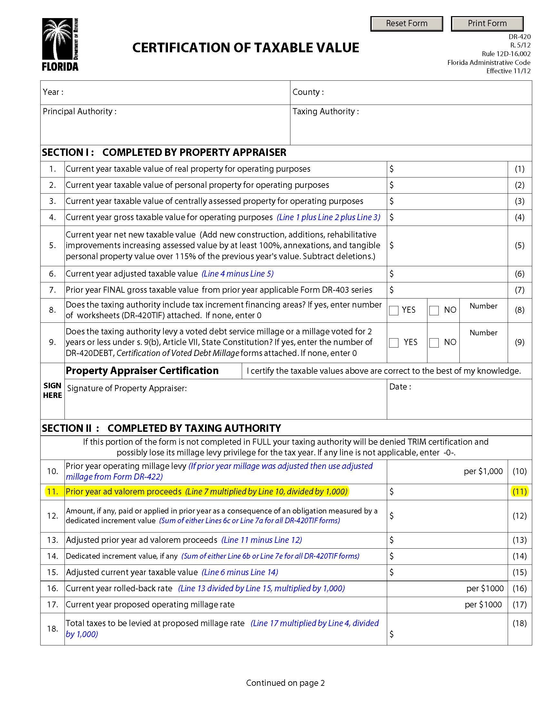
TRIM Advertising Requirements Notice of Proposed Tax Increase Ad
Line A = Prior year DR-420, line 25
Line B = Subtract line C from line A
Line C = Current year DR-420, line 11
This year’s proposed tax levy = current year’s tentatively adopted millage rate x current year gross taxable value ÷ 1,000 (line 4, current year DR-420)
*If the tentatively adopted millage rate is the same as the proposed millage rate, use current year DR-420 line 25.

Slide 21
TRIM Advertising Requirements Notice of Budget Hearing Ad
Budget hearing advertisement:
Must have an adjacent Budget Summary ad
Must appear in a newspaper of general paid circulation in the county or in its geographically limited insert
Doesn’t have a size requirement
Cannot appear in the newspaper’s legal section or classified section

Slide 22
TRIM Advertising Requirements Notice of Budget Hearing Ad
The advertisement:
As directed in s.200.065(3),(h), F.S., cannot deviate from the specified language.
Specified language is in s.200.065(3)(e).
Cannot be accompanied, preceded, or followed by other ads or notices which conflict with or contradict the required publications
Must advertise the final hearing within 15 days of tentative (first) hearing

Slide 23
TRIM Advertising Requirements Notice of Budget Hearing Ad EXAMPLE
NOTICE OF BUDGET HEARING
The ____________ has tentatively adopted
a budget for (fiscal year)
A public hearing to make a FINAL DECISION on the budget AND TAXES will be held on:
(Date)
(Time)
at
(Meeting Place)

Slide 24
TRIM Advertising Requirements Budget Summary Ad
The advertisement must show all tentatively adopted millage rates:
General fund
Dependent district
Municipal Service Taxing Unit (MSTU)
Voted debt service

Slide 25
TRIM Advertising Requirements Budget Summary Ad
Other requirements:
Must have an adjacent Notice of Proposed Tax Increase ad or Notice of Budget Hearing ad (not both)
Must comply with all statutory budget requirements
Has no size requirements
Cannot appear in the legal or classified section of the newspaper

Slide 26
TRIM Advertising Requirements Budget Summary Ad
If the proposed operating budget expenditures are more than last year's total operating expenditures, include this statement in bold.
THE PROPOSED OPERATING BUDGET
EXPENDITURES OF (name of taxing authority) ARE (percent, rounded to one decimal place) MORE THAN LAST YEAR'S TOTAL OPERATING EXPENDITURES.

Slide 27
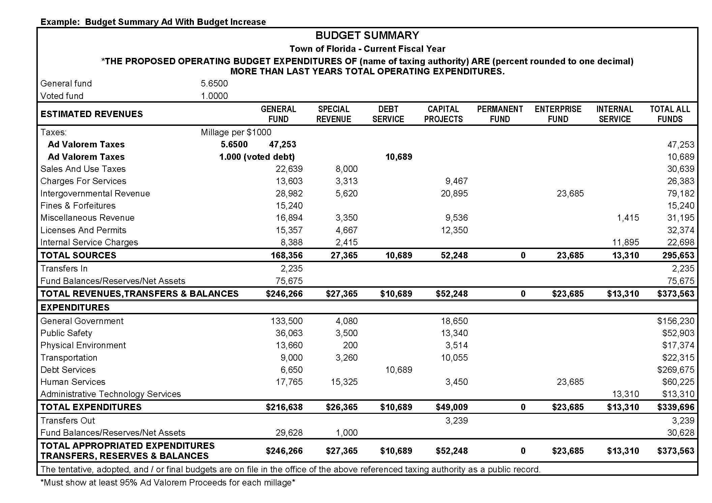
TRIM Advertising Requirements Budget Summary Ad

Slide 28
TRIM Advertising Requirements Recessed Hearing Information Ad
If the hearing is recessed, the taxing authority must publish a Notice of Continuation in a newspaper of general paid circulation in the county.
The notice will state the time, date, and location of the hearing.
Do not adjourn the hearing. The hearing is to be recessed.

Slide 29
TRIM Advertising Requirements Recessed Hearing Information Ad EXAMPLE
NOTICE OF CONTINUATION
The tentative/final budget hearing held on (date of hearing)
For the (name of taxing authority) was recessed and will be continued on
(Date, time, and location of new hearing).
(Include name of town)

Slide 30
TRIM Advertising Requirements Rescheduled Hearing Information Ad
If a hearing is postponed or rescheduled due to circumstances beyond the taxing authority’s control, the authority should publish a Notice of Rescheduled Hearing in a newspaper of general paid circulation in the county.
The notice must state the time, date, and location of the rescheduled hearing.

Slide 31
TRIM Advertising Requirements Rescheduled Hearing Information Ad EXAMPLE
NOTICE OF RESCHEDULED HEARING
The tentative/final hearing adopting a millage and budget on (hearing date)
for the (name of taxing authority) is being rescheduled due to (named storm).
A rescheduled (tentative/final) budget hearing will be held on:
(Date, time, and meeting place)

Slide 32
TRIM Advertising Requirements Proof of Publications
Submit entire page(s) for each published advertisement.
Submit these proofs of publication with Certification of Compliance (Form DR-487).

Slide 33
RESOLUTIONS/ORDINANCES

Slide 34
TRIM Resolution/Ordinance
The taxing authority cannot levy any millage until its governing board has approved a resolution or ordinance.

Slide 35
Example of Millage Resolution/Ordinance Ad

Slide 36
TRIM Millage Resolution/Ordinance
The tentative and final resolution/ordinance adopting millage rates must include:
The taxing authority’s name
The percentage increase over the rolled-back rate
Each adopted millage rate
The rolled-back rate

Slide 37
TRIM Budget Resolution/Ordinance
Must be adopted by separate vote after the millage adoption
If order of millage and budget adoption cannot be determined, send minutes of meeting
When the property appraiser receives the resolution or ordinance, the millage rate the taxing authority approved becomes official.

Slide 38
Example of Budget Resolution/Ordinance Ad

Slide 39
TRIM Resolution/Ordinance
Within three days following the final hearing, the taxing authority should forward the resolution/ordinance adopting final millage to the:
Property appraiser
Tax collector
Department of Revenue
trim@floridarevenue.com

