Slide 1
Welcome to the Department of Revenue’s
Truth in Millage (TRIM) Training

Slide 2
Overview
Introduction
TRIM Timetable
TRIM Certification Forms
Maximum Millage
TRIM Hearing Requirements
TRIM Advertising Requirements
Resolutions/Ordinances
Certifying Compliance to the Department
2020 Top Infractions and Violations
TRIM Compliance Contacts

Slide 3
Introduction
TRIM process and the public
Chapter 200, Florida Statutes

Slide 4
TRIM Timetable

Slide 5
TRIM Timetable
- The property appraiser (PA) provides total assessed value of nonexempt property to taxing authorities by June 1 for budget planning purposes.
- By July 1, the property appraiser certifies the taxable value to each taxing authority (TA) on Certification of Taxable Value (Form DR-420).

Slide 6
TRIM Timetable Day 1 = July 1
July
 |  |  | 1 | 2 | 3 | 4
5 | 6 | 7 | 8 | 9 | 10 | 11
12 | 13 | 14 | 15 | 16 | 17 | 18
19 | 20 | 21 | 22 | 23 | 24 | 25
26 | 27 | 28 | 29 | 30 | 31
The first day of the TRIM process is July 1, or the date of certification of taxable value, whichever is later.
DAY
1

Slide 7
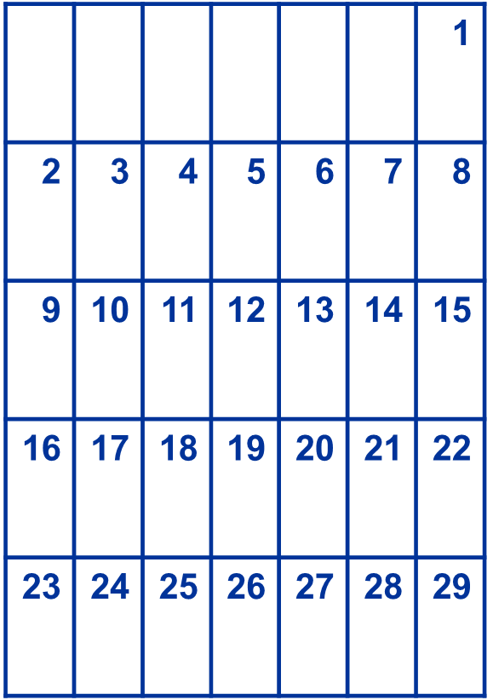
TRIM Timetable Day 35 = August 4
August
Within 35 days of certification of value, each taxing authority must inform the property appraiser of:
Prior year millage rate
Current year proposed millage rate
Current year rolled-back rate
The date, time, and meeting place of the tentative budget hearing

Slide 8
TRIM Timetable
If a taxing authority fails to provide the information to the property appraiser within 35 days:
The taxing authority will be prohibited from levying a millage rate greater than the rolled-back rate.
The property appraiser will compute the rolled-back rate and use it to prepare the Notice of Proposed Property Taxes.

Slide 9
TRIM Timetable Day 55 = August 24
August
- The property appraiser must mail the Notice of Proposed Property Taxes (TRIM notice) within 55 days of certification.
- If the Department of Revenue (Department) issues a review notice, the property appraiser cannot mail the TRIM notice until the Department has approved the assessment roll.
DAY
55

Slide 10
TRIM Timetable Days 65-80 = Sept. 3-18
The taxing authority should hold a public hearing on the tentative budget and proposed millage rate.
This tentative hearing is published on the TRIM notice the property appraiser mails.

Slide 11
TRIM Timetable Days 81-95 = Sept. 19-Oct. 3
Within 15 days after the tentative hearing, the taxing authority must advertise its intent to adopt a final millage and budget. The notification may be:
A Notice of Proposed Tax Increase, or
A Notice of Budget Hearing and
A Budget Summary Ad

Slide 12
TRIM Timetable Days 97 – 100 = Final Hearing
The taxing authority should hold a public hearing on the final millage rates and budget 97-100 days after certification of value.
This final hearing should be held two – five days after the hearing is advertised.

Slide 13
TRIM Timetable Within Three Days of Final Hearing
The taxing authority forwards the resolution or ordinance adopting the final millage rate to the property appraiser, tax collector, and to the Department.
When the property appraiser receives the resolution or ordinance, notification of the final millage rate is considered official.

Slide 14
TRIM Timetable Within 30 Days of Final Hearing
Each taxing authority must certify compliance to the Department.
Do not wait to certify compliance if you have not received Certification of Final Taxable Value, (Form DR-422) from the property appraiser.
Complete Form DR-422 as soon as you receive it and forward it to the property appraiser. Also, send a copy to the Department’s Property Tax Oversight TRIM section.

Slide 15
TRIM Certification Forms

Slide 16
TRIM Certification Forms
Certification of Taxable Value
(Form DR-420)
Certification of Voted Debt Millage
(Form DR-420DEBT)
Tax Increment Adjustment Worksheet
(Form DR-420TIF)
Maximum Millage Levy Calculation Preliminary Disclosure
(Form DR-420MM-P)

Slide 17
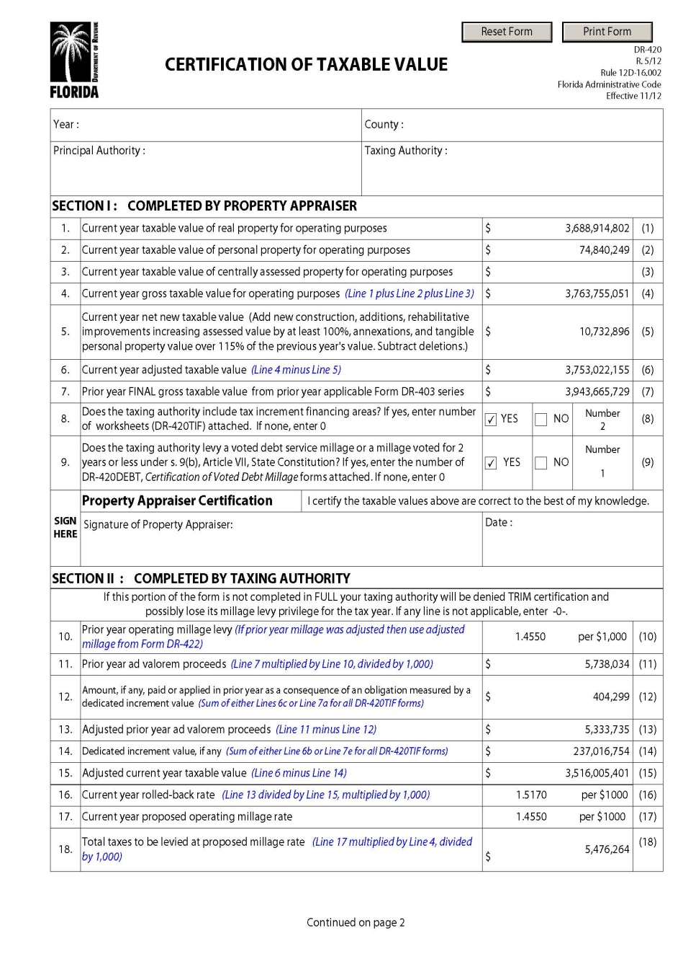
Certification of Taxable Value (Form DR-420)
July 1
- PA certifies initial values.
- TA:
Enters prior year millage rate
Calculates rolled-back rate
Enters proposed millage rate

Slide 18
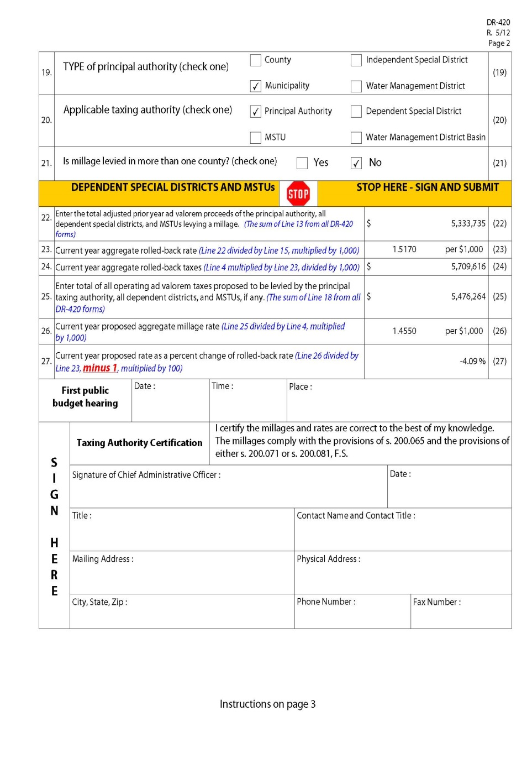
Certification of Taxable Value (Form DR-420)
TA:
Calculates percentage change of rolled-back rate
Enters tentative budget hearing
Returns completed form within 35 days of certification

Slide 19
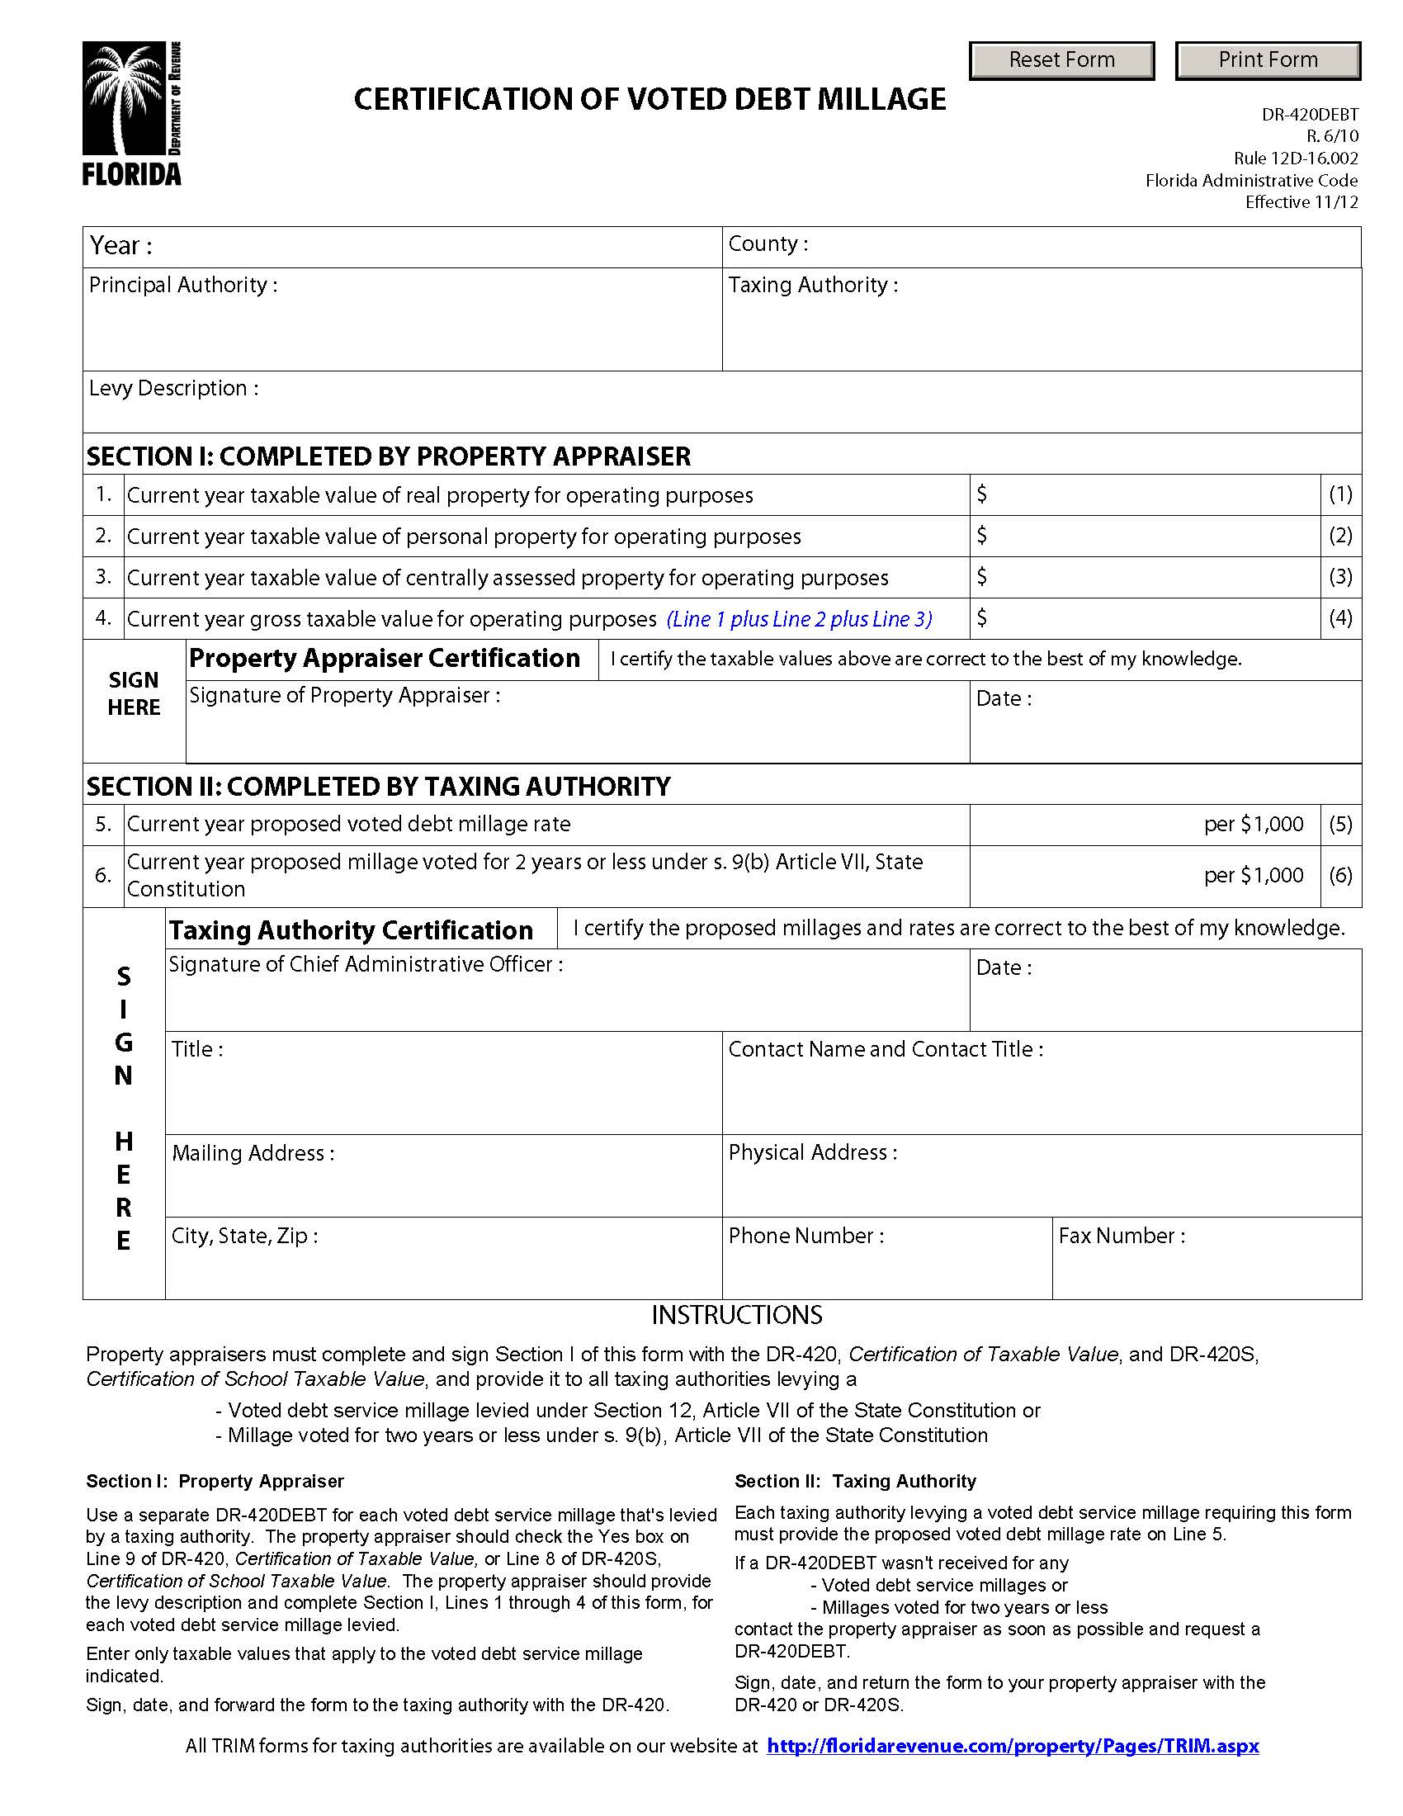
Certification of Voted Debt Millage (Form DR-420DEBT)
July 1
- PA certifies initial values.
- TA:
Completes either line 5 or line 6
Returns completed form within 35 days of certification

Slide 20
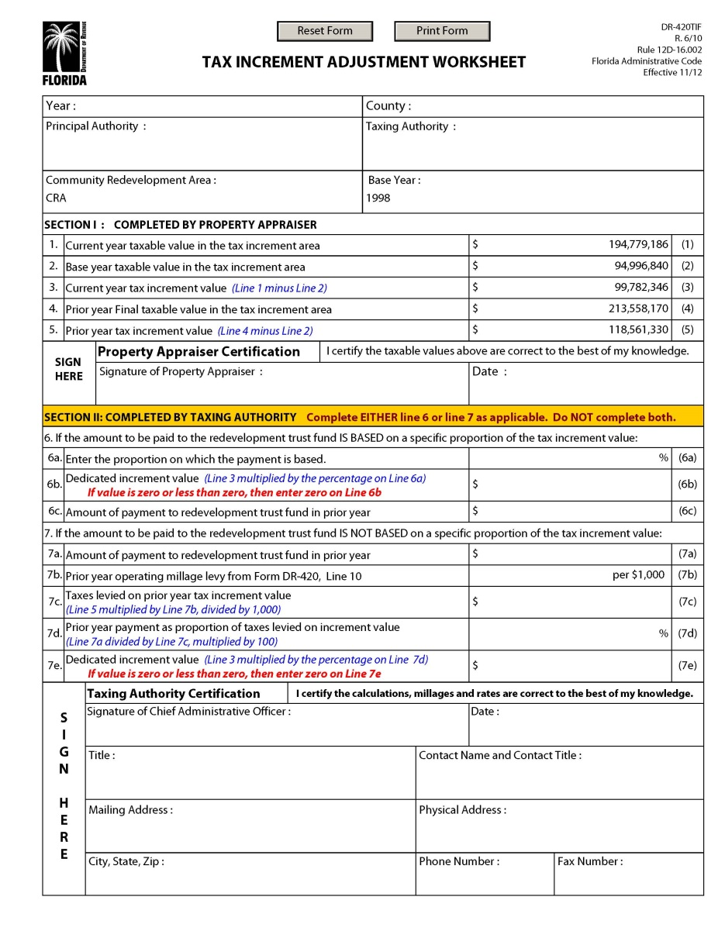
Tax Increment Adjustment Worksheet (Form DR-420TIF)
July 1
PA certifies values.
TA:
Completes either line 6 or line 7
Returns completed form within 35 days of certification

Slide 21
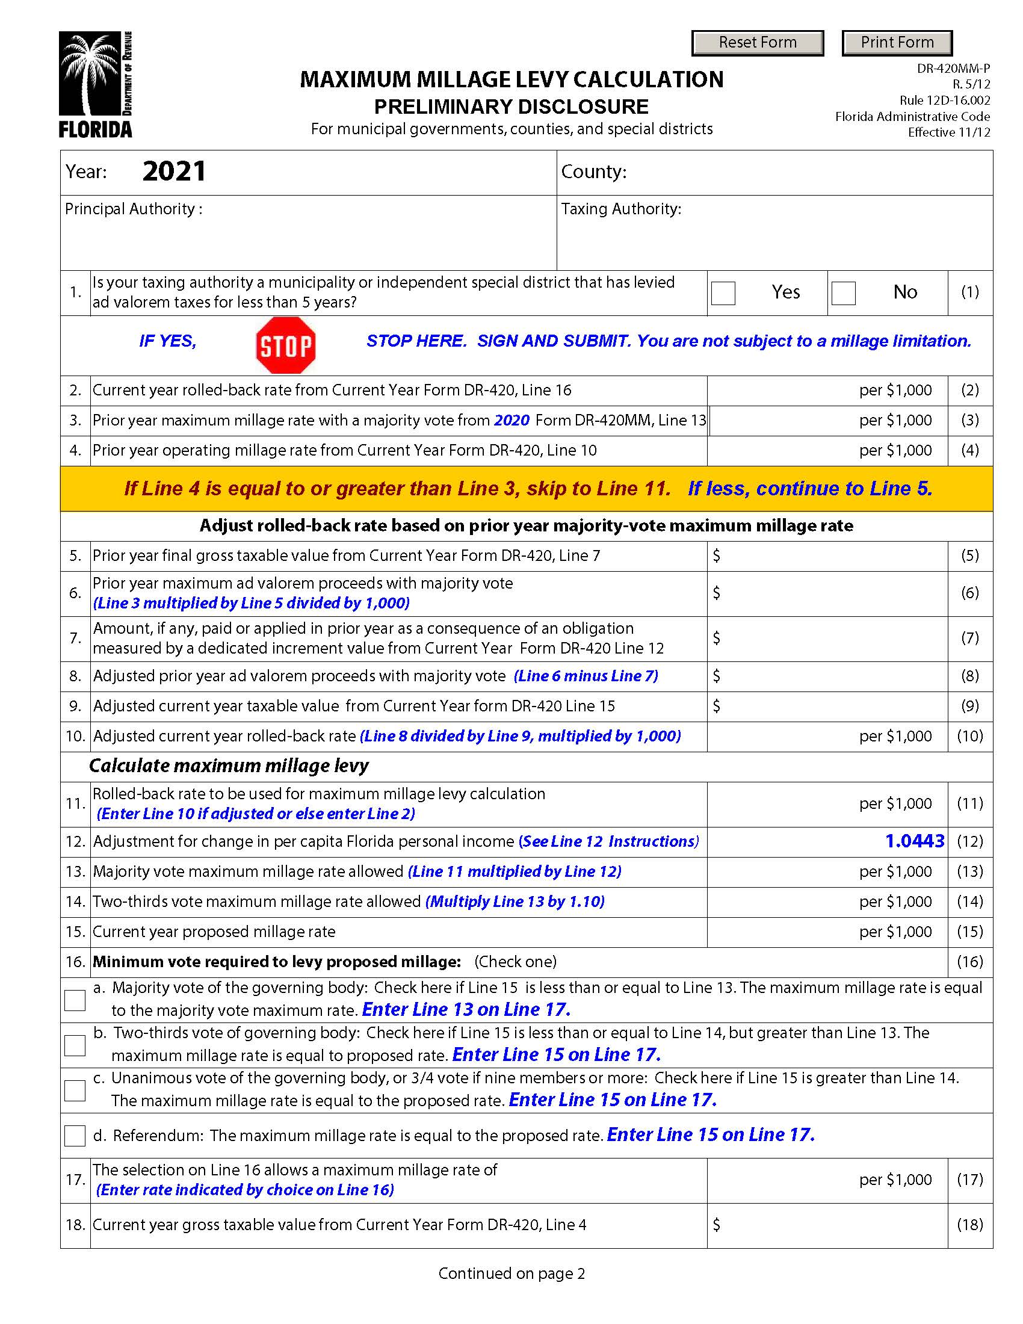
Maximum Millage Preliminary Disclosure (Form DR-420MM-P)
Enter current year proposed millage
The millage rate determines the type of vote needed to adopt millage

Slide 22
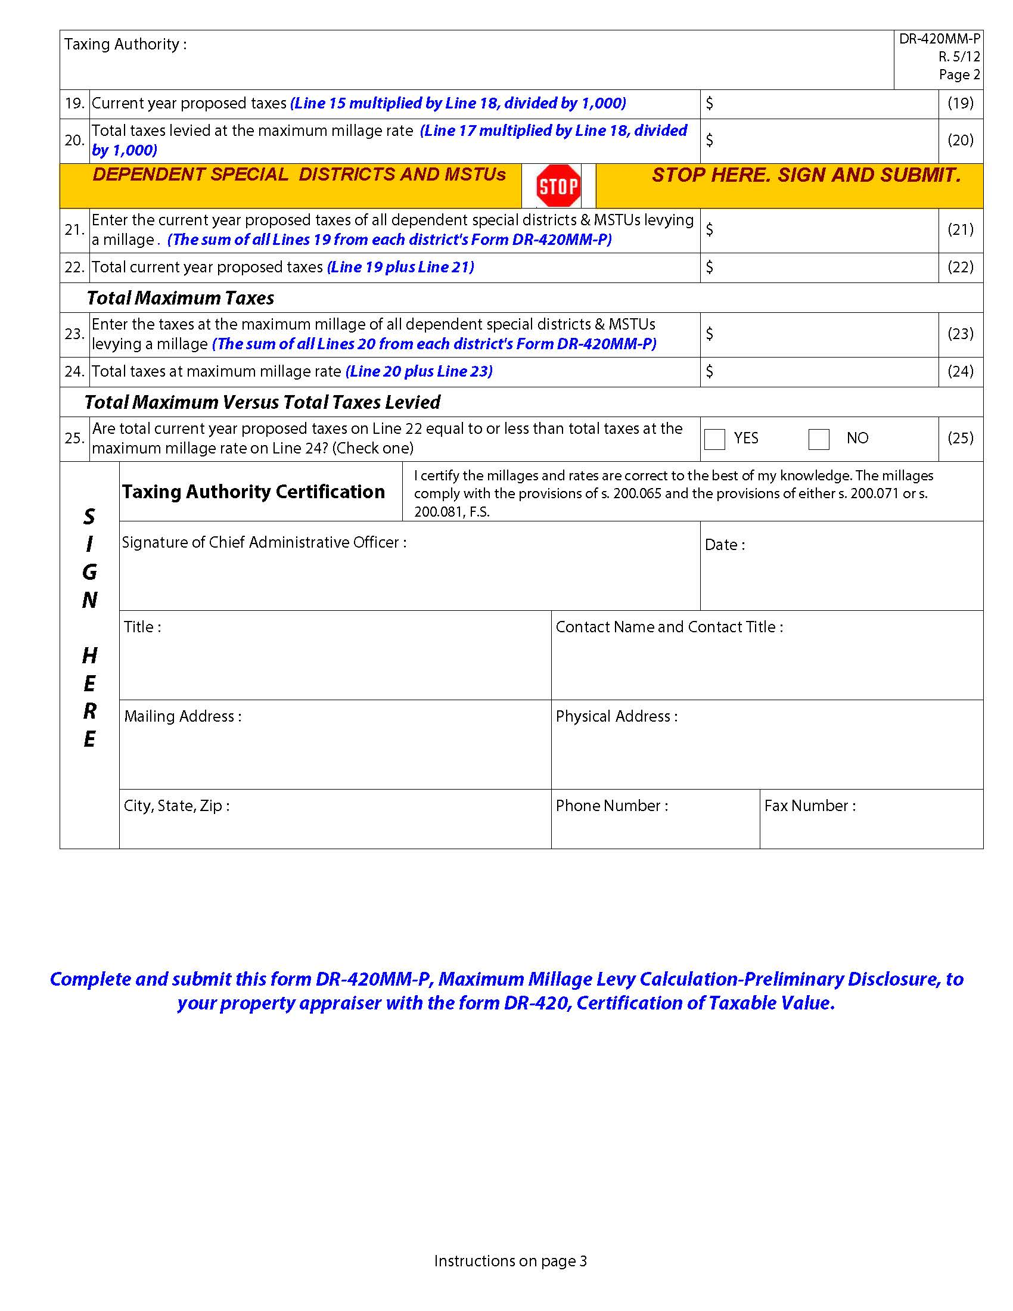
Maximum Millage Preliminary Disclosure (Form DR-420MM-P)
Line 25 determines compliance with maximum millage laws.

Slide 23
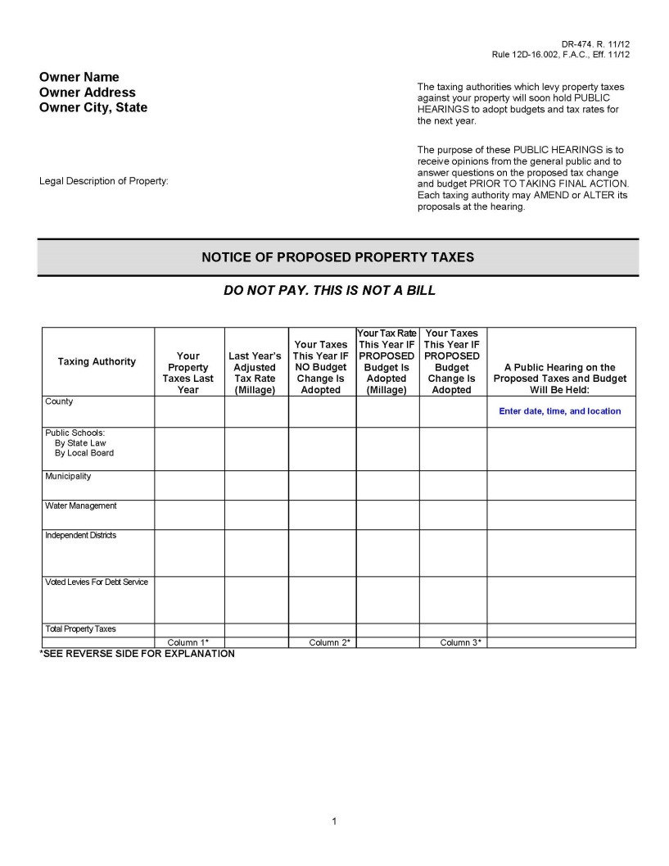
Notice of Proposed Property Taxes (Form DR-474)

Slide 24
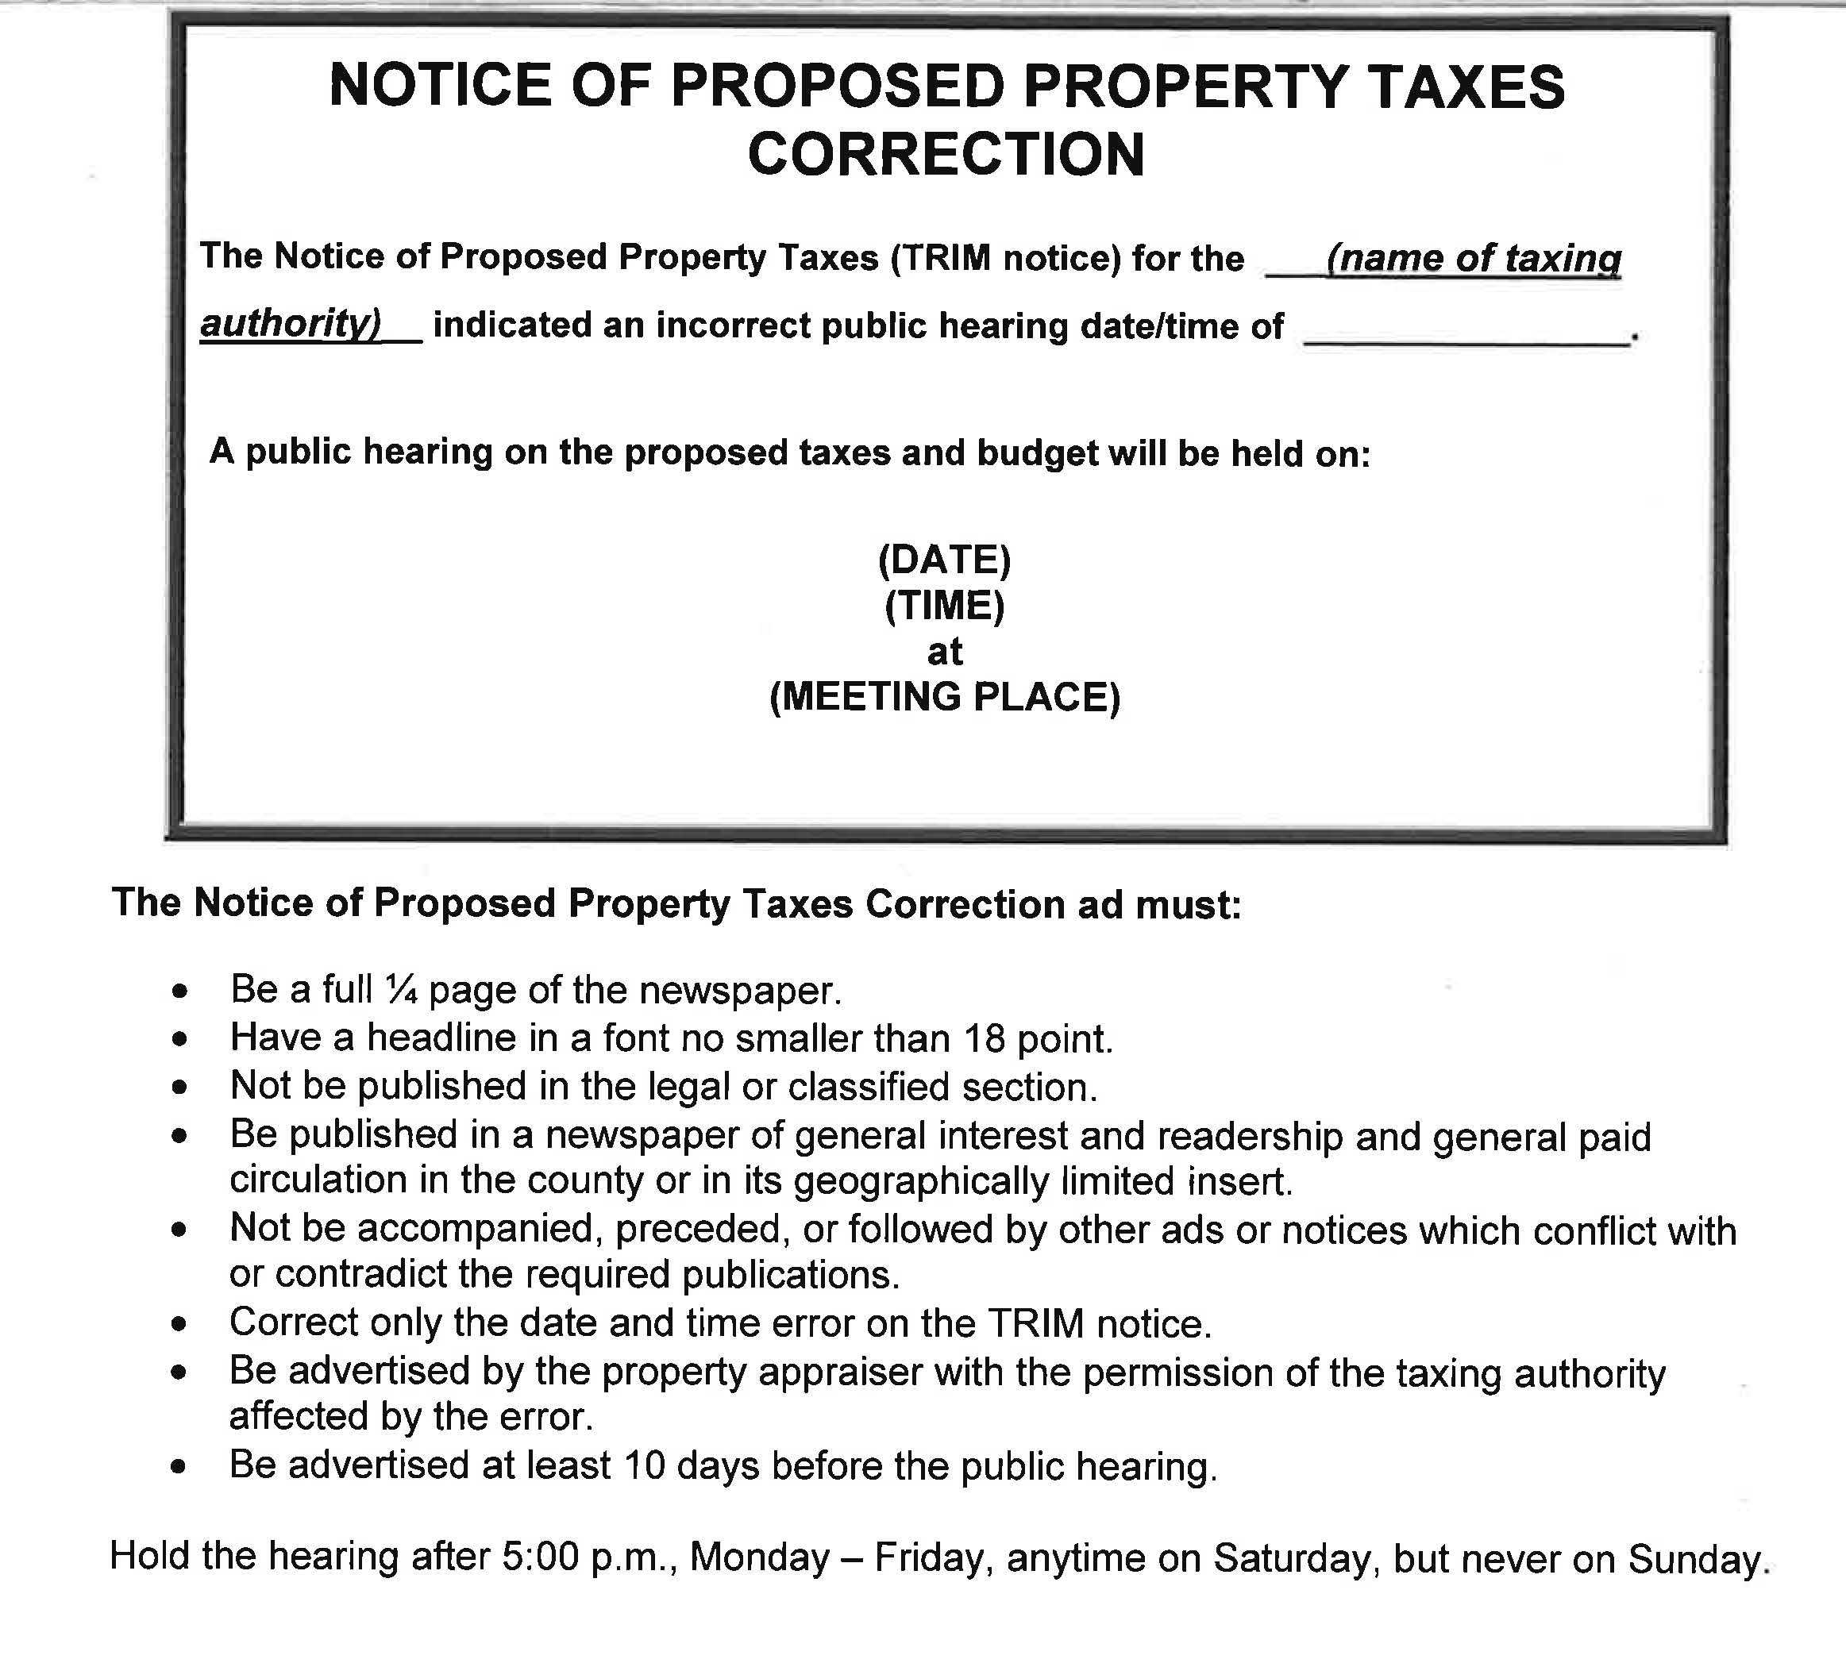
Notice of Proposed Property Taxes Correction

Slide 25
Maximum Millage

Slide 26
Maximum Millage
Local governments must conform to the maximum millage limitation statutory requirements by adopting a millage rate through a vote that is one of the following:
Majority vote
Two-thirds
Unanimous vote

Slide 27
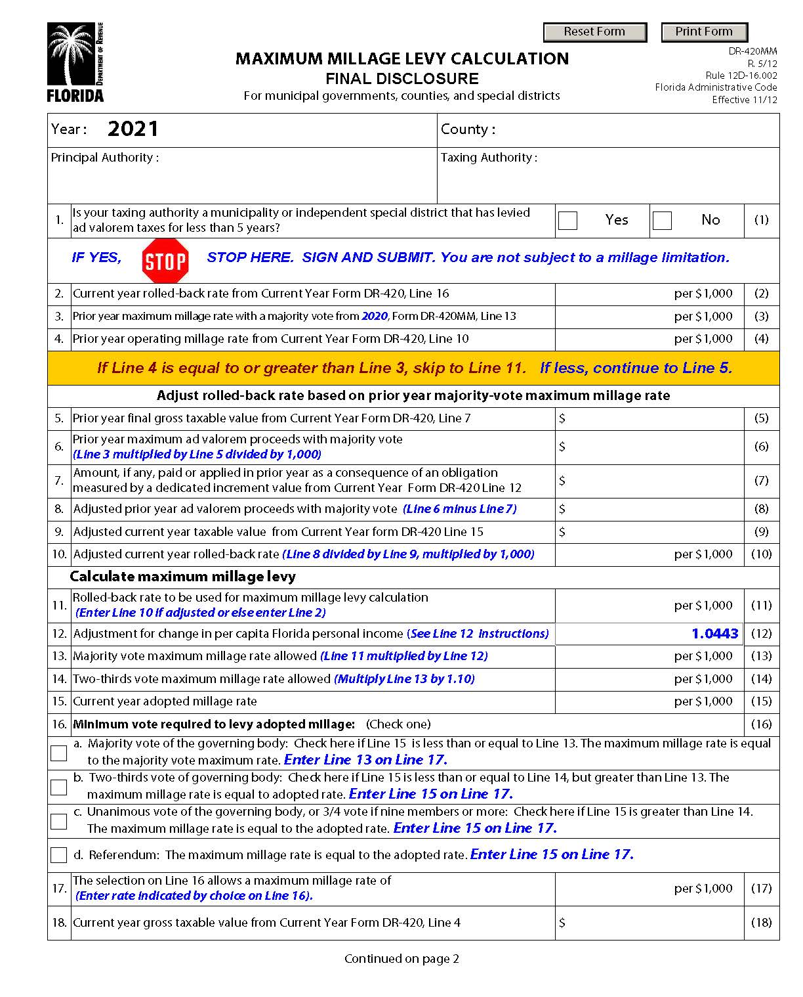
Maximum Millage Final Disclosure (Form DR-420MM)
Enter current year adopted millage
The millage rate determines the type of vote needed to adopt millage

Slide 28
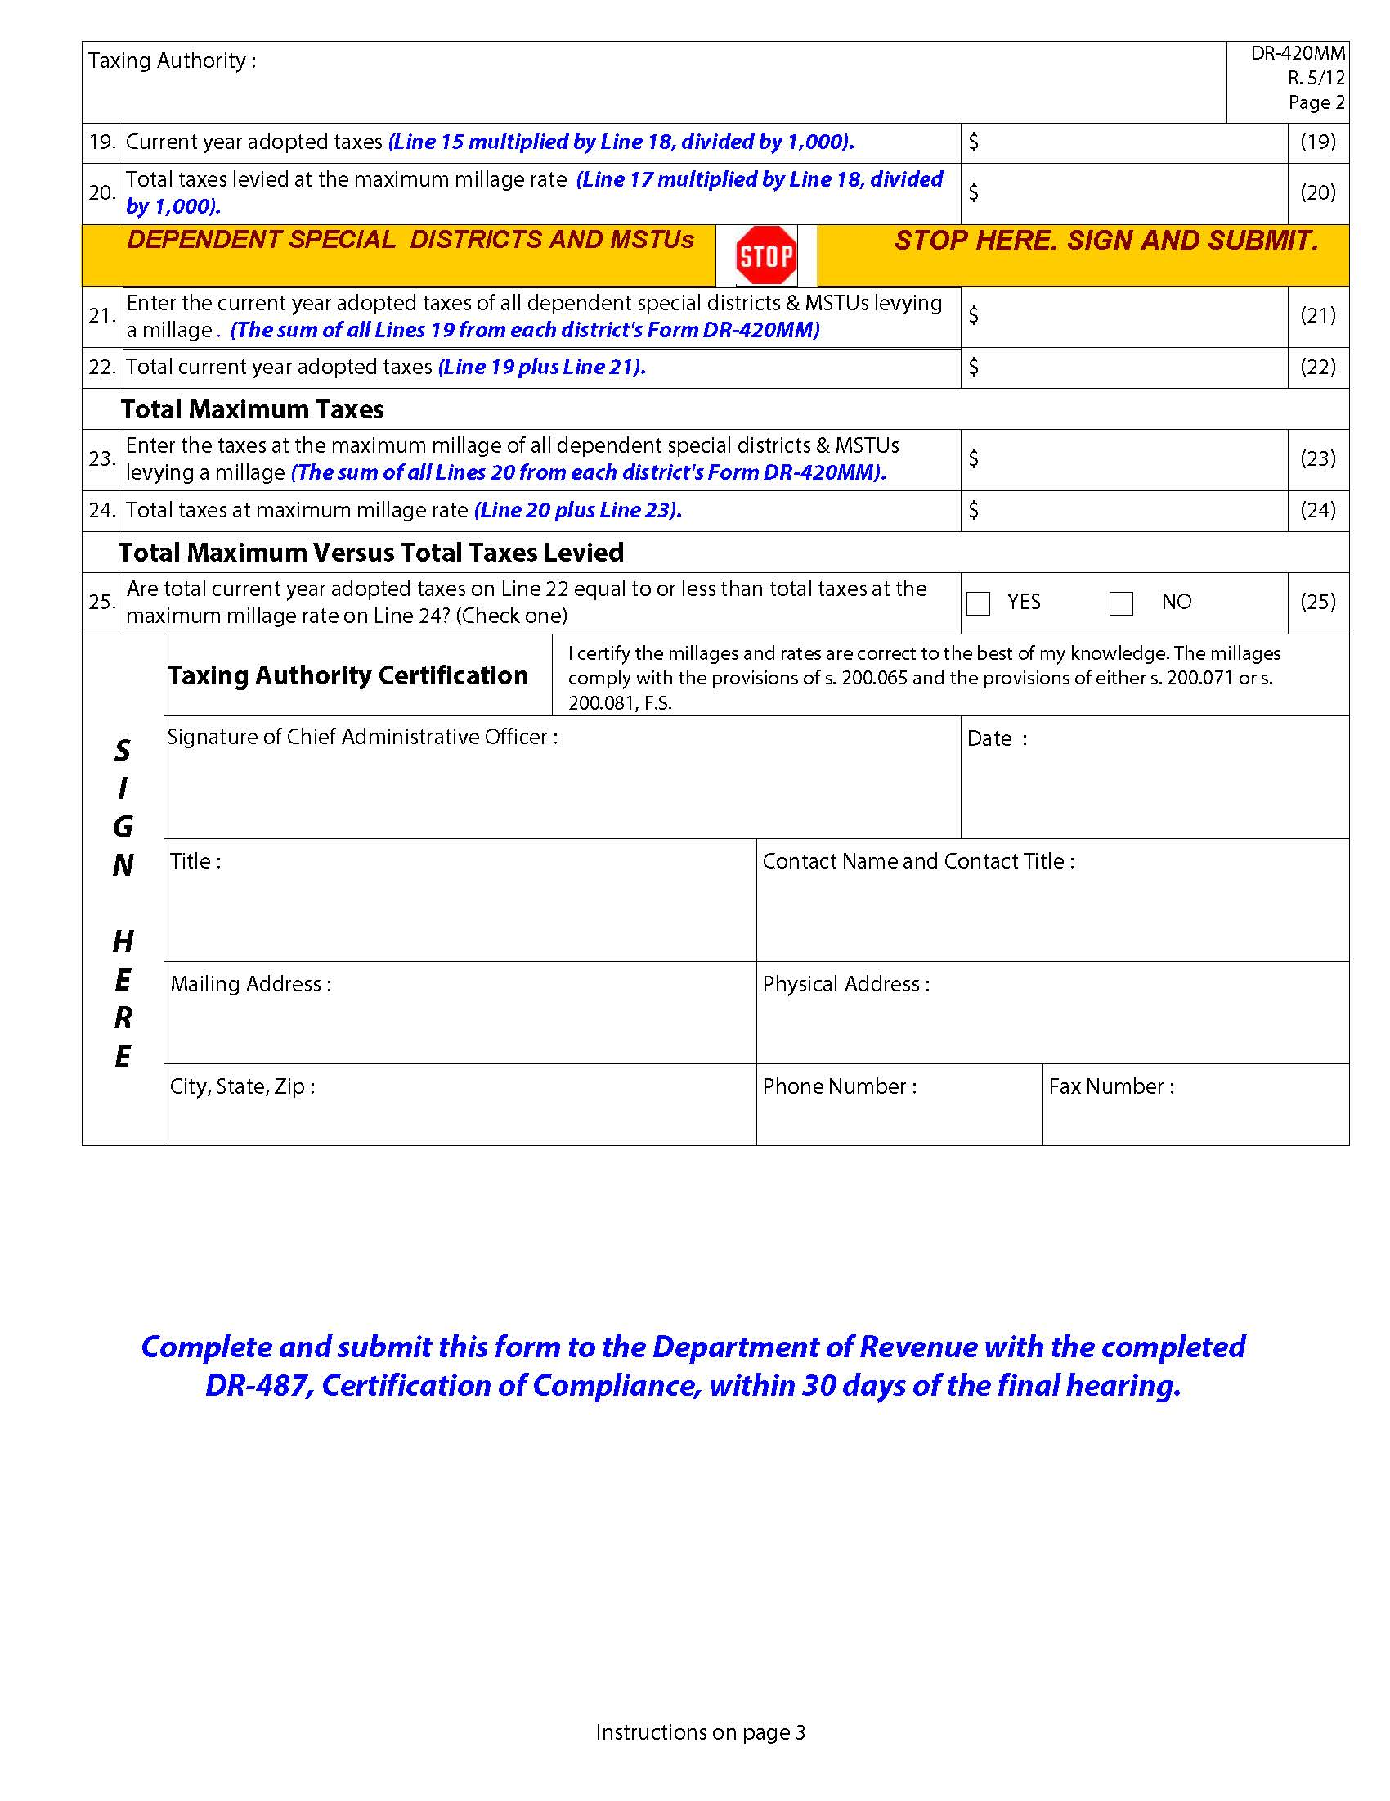
Maximum Millage Final Disclosure (Form DR-420MM)
Line 25 determines compliance with maximum millage laws.

Slide 29
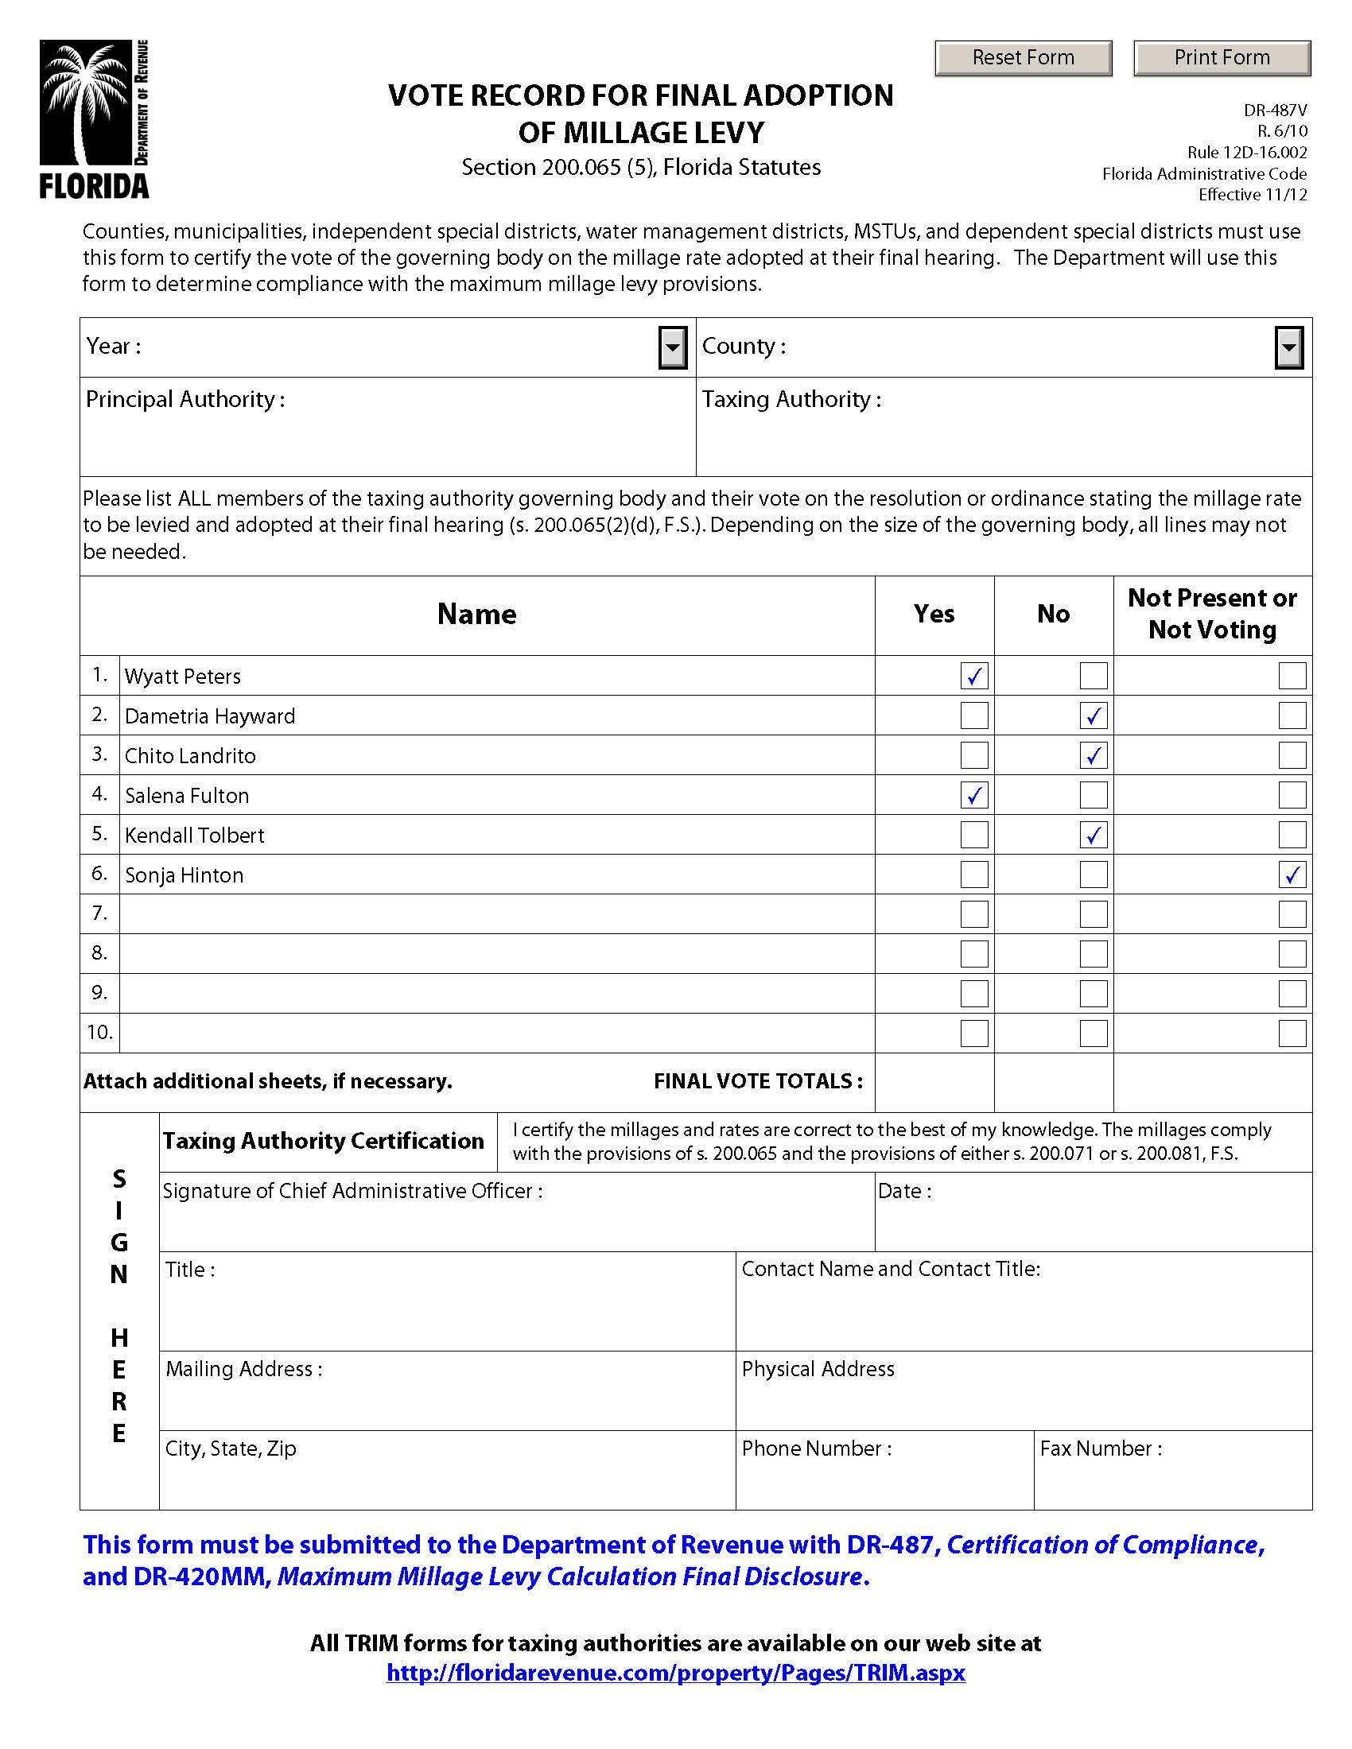
Vote Record (Form DR-487V)
Must be completed with the DR-420MM
List all board members and how they voted

Slide 30
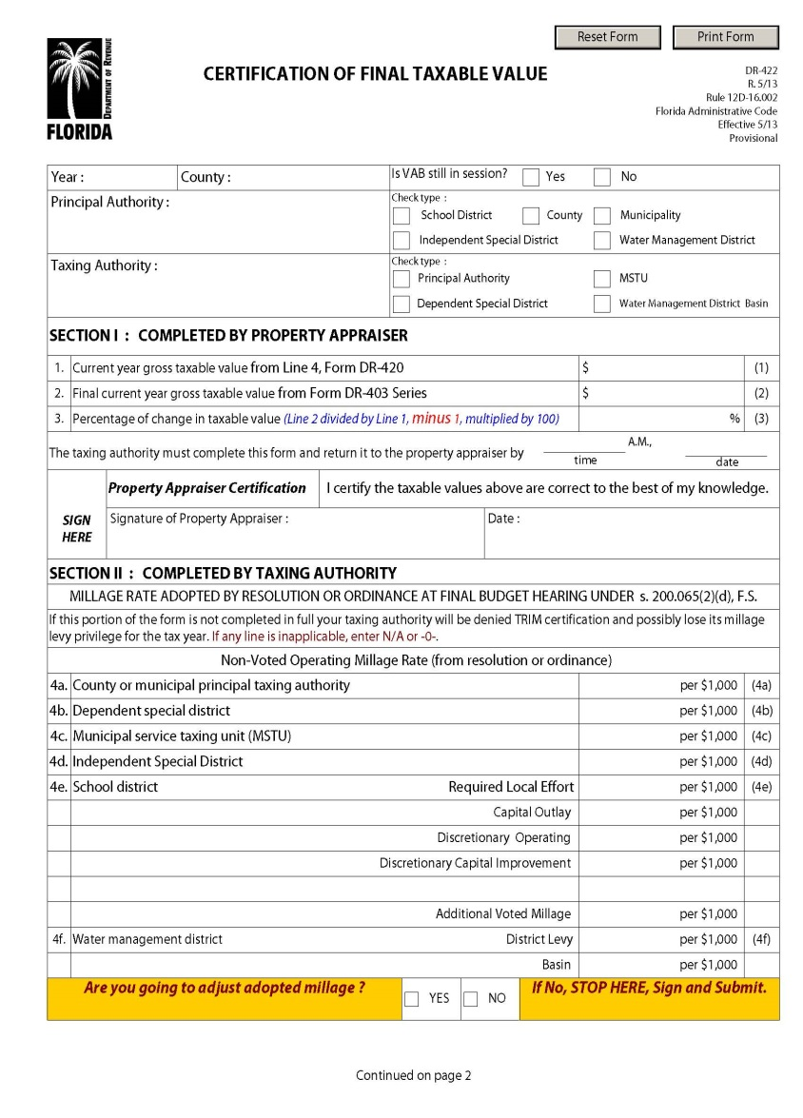
Certification of Final Taxable Value (Form DR-422)
- PA certifies final taxable value.
- TA enters final millage rate.

Slide 31
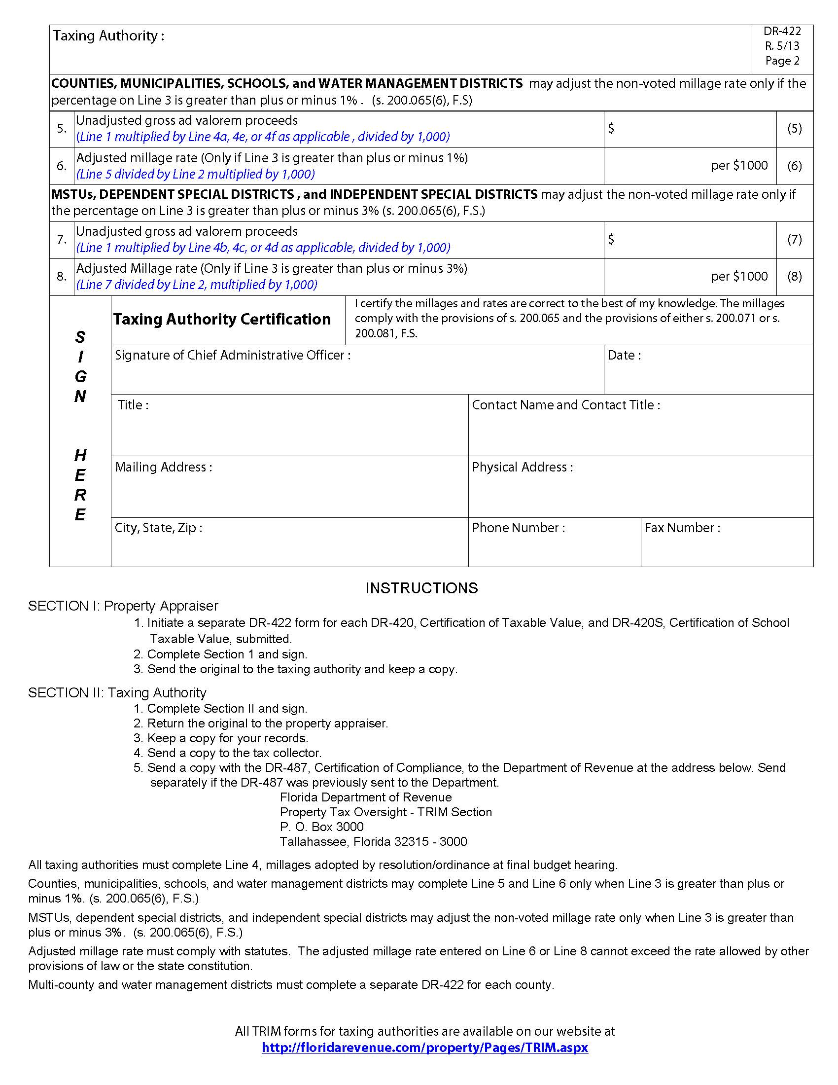
Certification of Final Taxable Value (Form DR-422)
The taxing authority may adjust the millage rate.

Slide 32
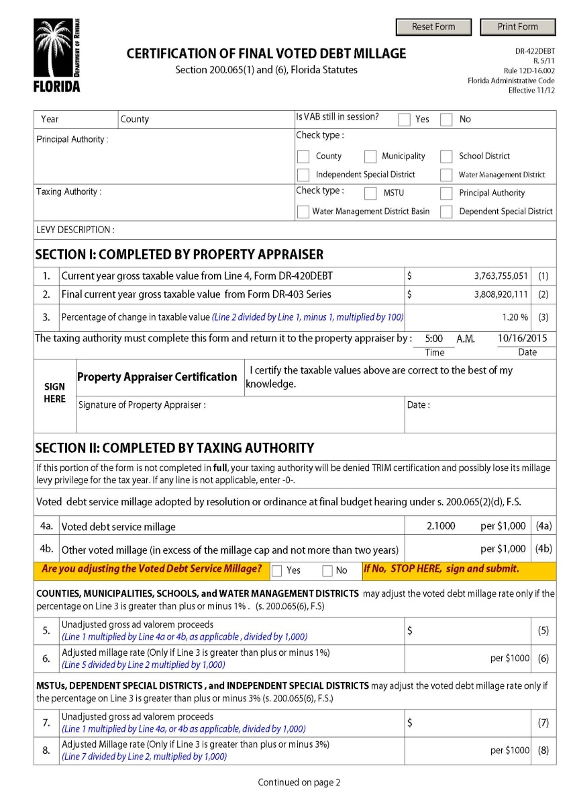
Certification of Final Voted Debt Millage (Form DR-422DEBT)
- PA certifies final taxable value.
- TA enters:
Final millage rate
Adjusted millage rate

Slide 33
TRIM Hearing Requirements

Slide 34
TRIM Hearing Information
Taxing authorities must hold two public hearings to adopt a millage rate and budget.

Slide 35
TRIM Hearing Information Scheduling and Advertising Hearing
TRIM hearings may be held:
Monday – Friday after 5:00 p.m.
Any time on Saturday
Never on Sunday

Slide 36
TRIM Hearing Information Scheduling and Advertising Hearing
The school board has first priority of a hearing date.
The board of County Commissioners (BOCC) has second choice.
No other taxing authority in the county can hold a hearing on the same date as the school board or BOCC.

Slide 37
TRIM Hearing Information Scheduling and Advertising Hearing
The tentative TRIM hearing is advertised on the TRIM notice.
The final hearing must be advertised within 15 days of adopting the tentative millage and budget.

Slide 38
TRIM Hearing Information At the Hearing
The first issues discussed will be:
Percentage increase in millage over the rolled-back rate necessary to fund the budget, if any
Specific reasons why ad valorem tax revenues are increasing

Slide 39
TRIM Hearing Information At the Hearing
The general public may speak and ask questions before the governing body adopts any measures.
The governing body must adopt its tentative or final millage rate before adopting its tentative or final budget.
Adopt millage first; adopt budget second.

Slide 40
TRIM Hearing Information At the Hearing
Each taxing authority levying a millage rate must publicly announce, before adopting the millage resolution:
The taxing authority’s name
The rolled-back rate
The percentage increase over the rolled-back rate
The millage rate to be levied

Slide 41
TRIM Hearing Information At the Hearing
The tentative millage rate cannot exceed the proposed millage rate unless the property appraiser mails each taxpayer a revised TRIM notice at the taxing authority’s expense.
The final millage rate cannot exceed the tentatively adopted millage rate.
The TRIM process must be completed within 101 days.

Slide 42
TRIM Hearing Information At the Hearing
The taxing authority cannot levy any millage until its governing board has approved a resolution or ordinance.

Slide 43
Executive Order for State of Emergency
Executive Order
In the event of a state of emergency, declared because of an imminent tropical storm, hurricane, or other calamity, the governor of the State of Florida will issue an executive order. The executive order will provide pertinent information and guidance, such as:
A list of the counties or areas impacted by the emergency event
Suspension of the effect of any statute, rule, or order that would prevent, hinder, or delay any action necessary to cope with the emergency

Slide 44
Executive Order for State of Emergency
Department Emergency Order
The executive director of the Department will in turn issue an emergency order to implement the provisions of the governor’s order. The emergency order will provide specific guidance with regard to the TRIM process, such as:
A list of the counties impacted
Extension of TRIM timelines
Temporarily waived TRIM compliance requirements
Specific guidance related to TRIM hearing and advertising requirements

Slide 45
TRIM Advertising Requirements

Slide 46
TRIM Advertising Requirements
Taxing authorities must select the appropriate newspaper advertisement to announce the final TRIM hearing.

Slide 47
TRIM Advertising Requirements Advertisement Selection
After calculating the percentage change of rolled-back rate, choose the proper notice:
Publish a Notice of Proposed Tax Increase when percent change is greater than 0%.
Publish a Notice of Budget Hearing when the percent change is equal to or less than 0%.

Slide 48
TRIM Advertising Requirements Notice of Proposed Tax Increase Ad
Must be no smaller than a quarter-page advertisement
Must have a headline in at least 18-point type
Must have an adjacent Budget Summary ad
Must appear in a newspaper of general paid circulation in the county or in its geographically limited insert
Cannot appear in the legal section or classified section of the newspaper

Slide 49
TRIM Advertising Requirements Notice of Proposed Tax Increase Ad
The advertisement:
As stated in section 200.065(3),(h), Florida Statutes (F.S.), cannot deviate from specified statutory language.
Cannot be accompanied, preceded, or followed by other ads or notices which conflict with or contradict the required publications
Must advertise the final hearing within 15 days of tentative (first) hearing

Slide 50
TRIM Advertising Requirements Date for Final Hearing
The final hearing must be held two to five days after advertising.

Slide 51
TRIM Advertising Requirements Notice of Proposed Tax Increase Ad EXAMPLE
Use 100% of tax levies in advertisement

Slide 52
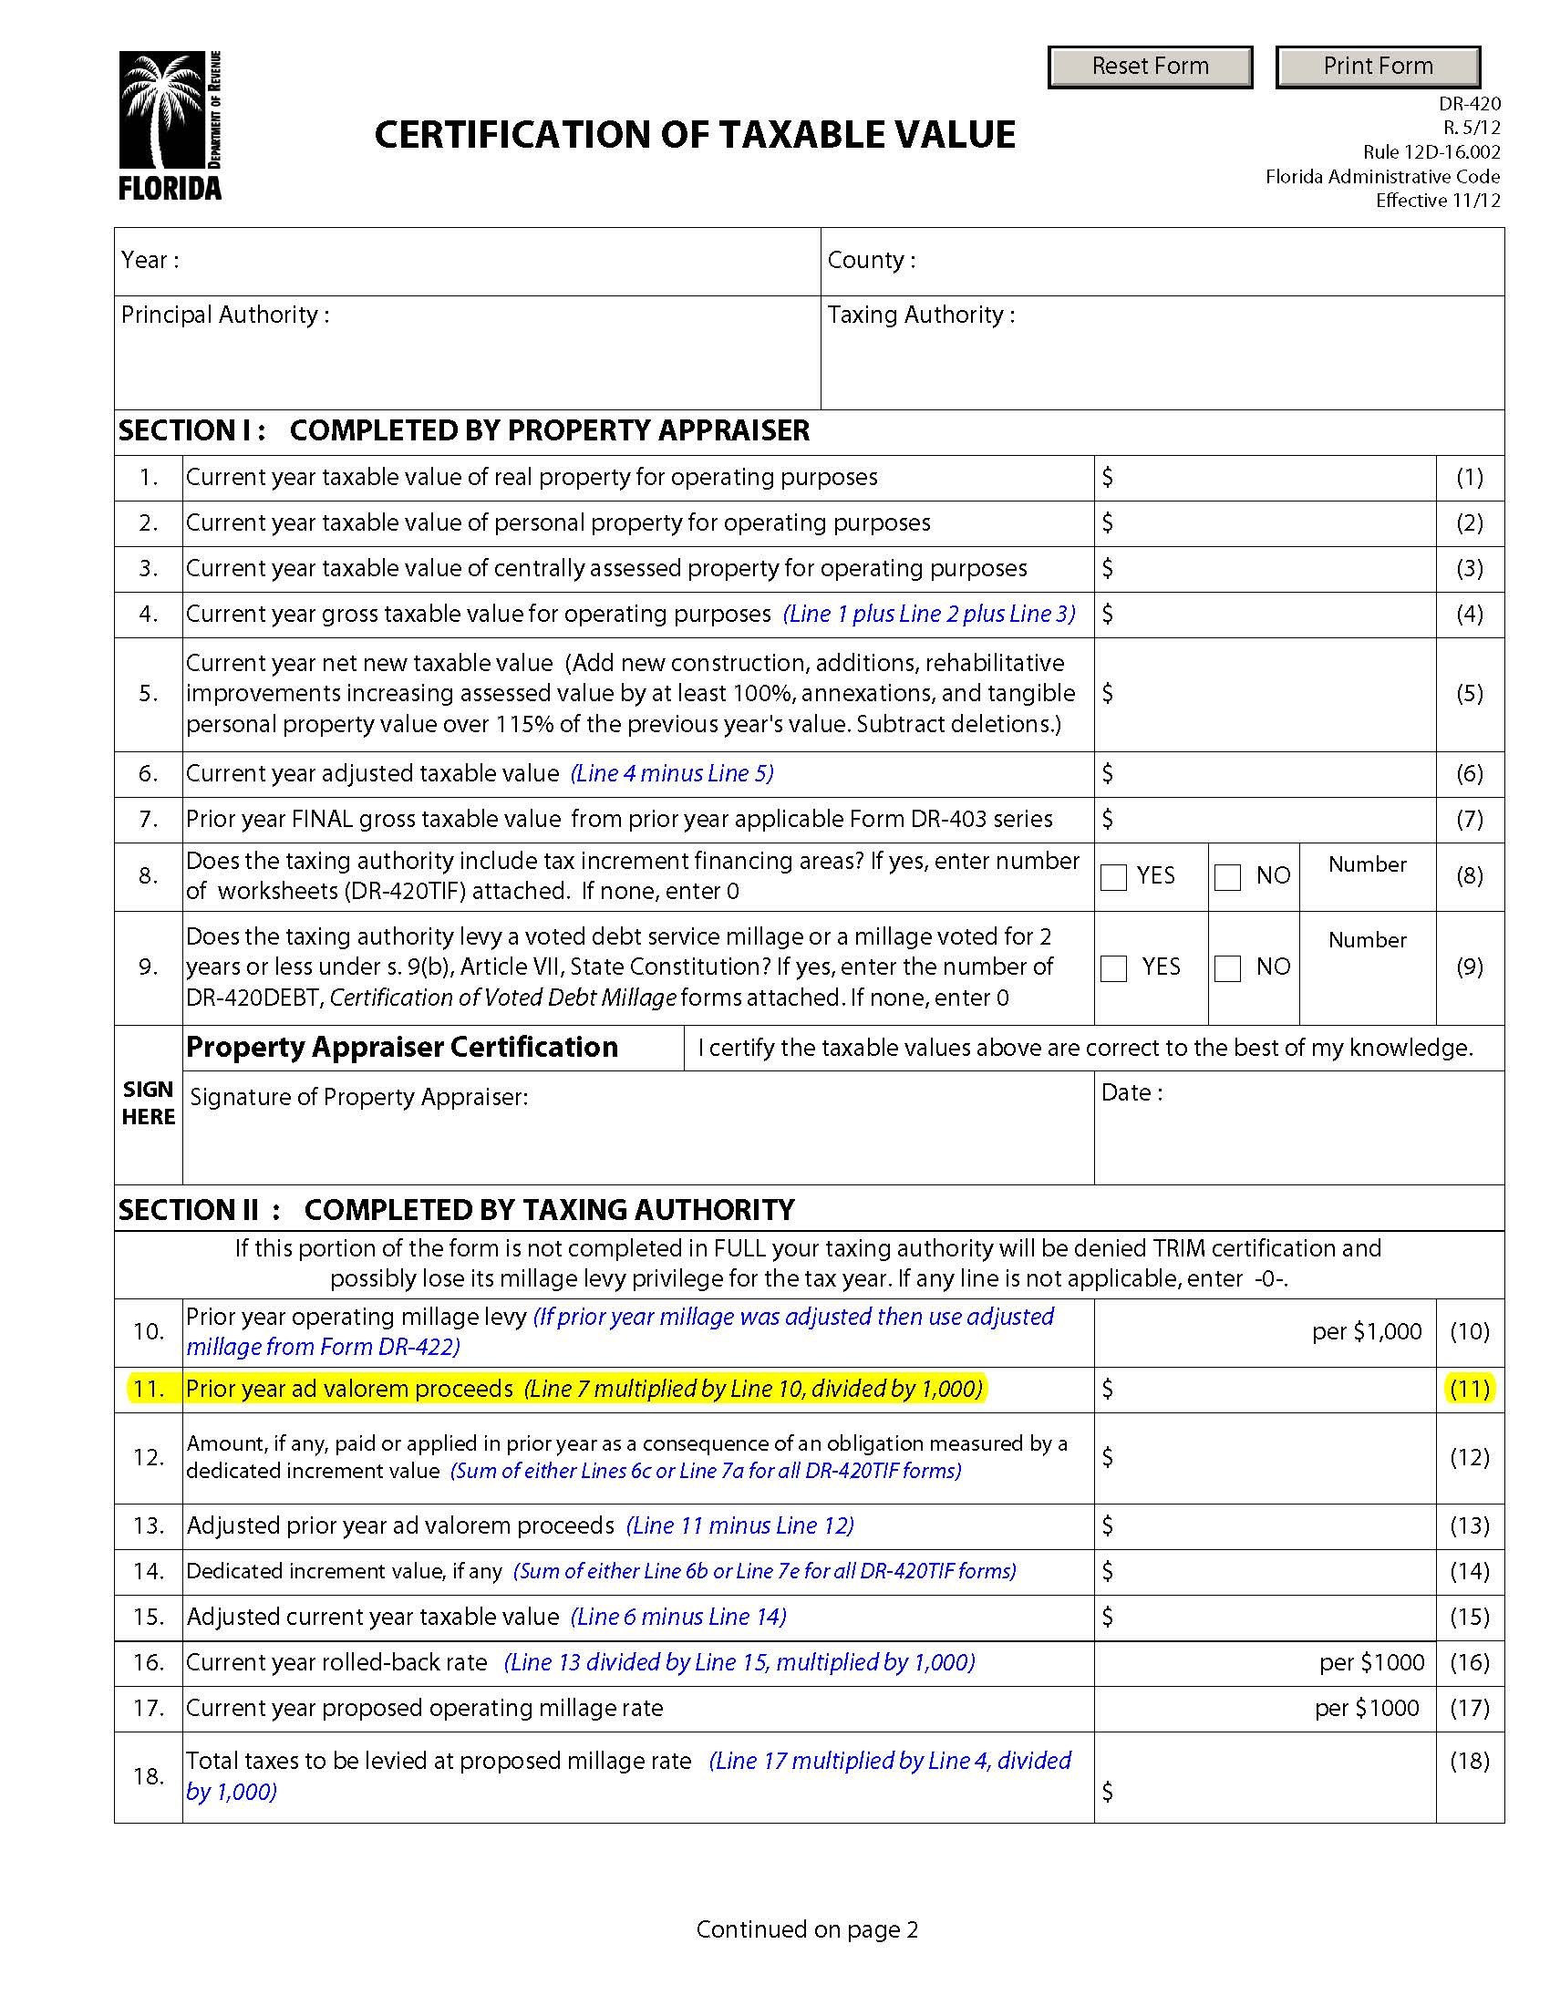
TRIM Advertising Requirements Notice of Proposed Tax Increase Ad
Line A = Prior year DR-420, line 25
Line B = Subtract line C from line A
Line C = Current year DR-420, line 11
This year’s proposed tax levy = current year’s tentatively adopted millage rate x current year gross taxable value ÷ 1,000 (line 4, current year DR-420)
*If the tentatively adopted millage rate is the same as the proposed millage rate, use current year
DR-420 line 25

Slide 53
TRIM Advertising Requirements Notice of Budget Hearing
Budget hearing advertisement:
Doesn’t have a size requirement
Must have an adjacent Budget Summary ad
Must appear in a newspaper of general paid circulation in the county or in its geographically limited insert
Cannot appear in the newspaper’s legal section or classified section

Slide 54
TRIM Advertising Requirements Notice of Budget Hearing
The advertisement:
As stated in s.200.065(3),(h), Florida Statutes (F.S.), cannot deviate from specified statutory language.
Cannot be accompanied, preceded, or followed by other ads or notices which conflict with or contradict the required publications
Must advertise the final hearing within 15 days of tentative (first) hearing

Slide 55
TRIM Advertising Requirements Notice of Budget Hearing
The final hearing must be held two to five days after advertising.

Slide 56
TRIM Advertising Requirements Notice of Budget Hearing EXAMPLE
NOTICE OF BUDGET HEARING
The ____________ has tentatively adopted
a budget for (fiscal year)
A public hearing to make a FINAL DECISION on the budget AND TAXES will be held on:
(Date)
(Time)
at
(Meeting Place)

Slide 57
TRIM Advertising Requirements Budget Summary Ad
The advertisement must show all tentatively adopted millage rates:
General fund
Dependent district
Municipal Service Taxing Unit (MSTU)
Voted debt service

Slide 58
TRIM Advertising Requirements Budget Summary Ad
For this advertisement:
Each millage rate must include at least 95% of ad valorem taxes in the budget.
All funds must be shown.
The ad must show a balanced budget.
All funds should balance.
The total of all funds should balance.
A line item for reserves must be shown.

Slide 59
TRIM Advertising Requirements Budget Summary Ad
Other requirements:
The ad must have an adjacent Notice of Proposed Tax Increase ad or Notice of Budget Hearing ad (not both).
The ad cannot appear in the legal or classified section of the newspaper.
This ad has no size requirements.
The ad must comply with all statutory budget requirements.

Slide 60
TRIM Advertising Requirements Budget Summary Ad
If the proposed operating budget expenditures are more than last year's total operating expenditures, include this statement in bold. For example:
THE PROPOSED OPERATING BUDGET
EXPENDITURES OF (name of taxing authority) ARE (percent, rounded to one decimal place) MORE THAN LAST YEAR'S TOTAL OPERATING EXPENDITURES. (s.200.065(3)(l), F.S.)

Slide 61
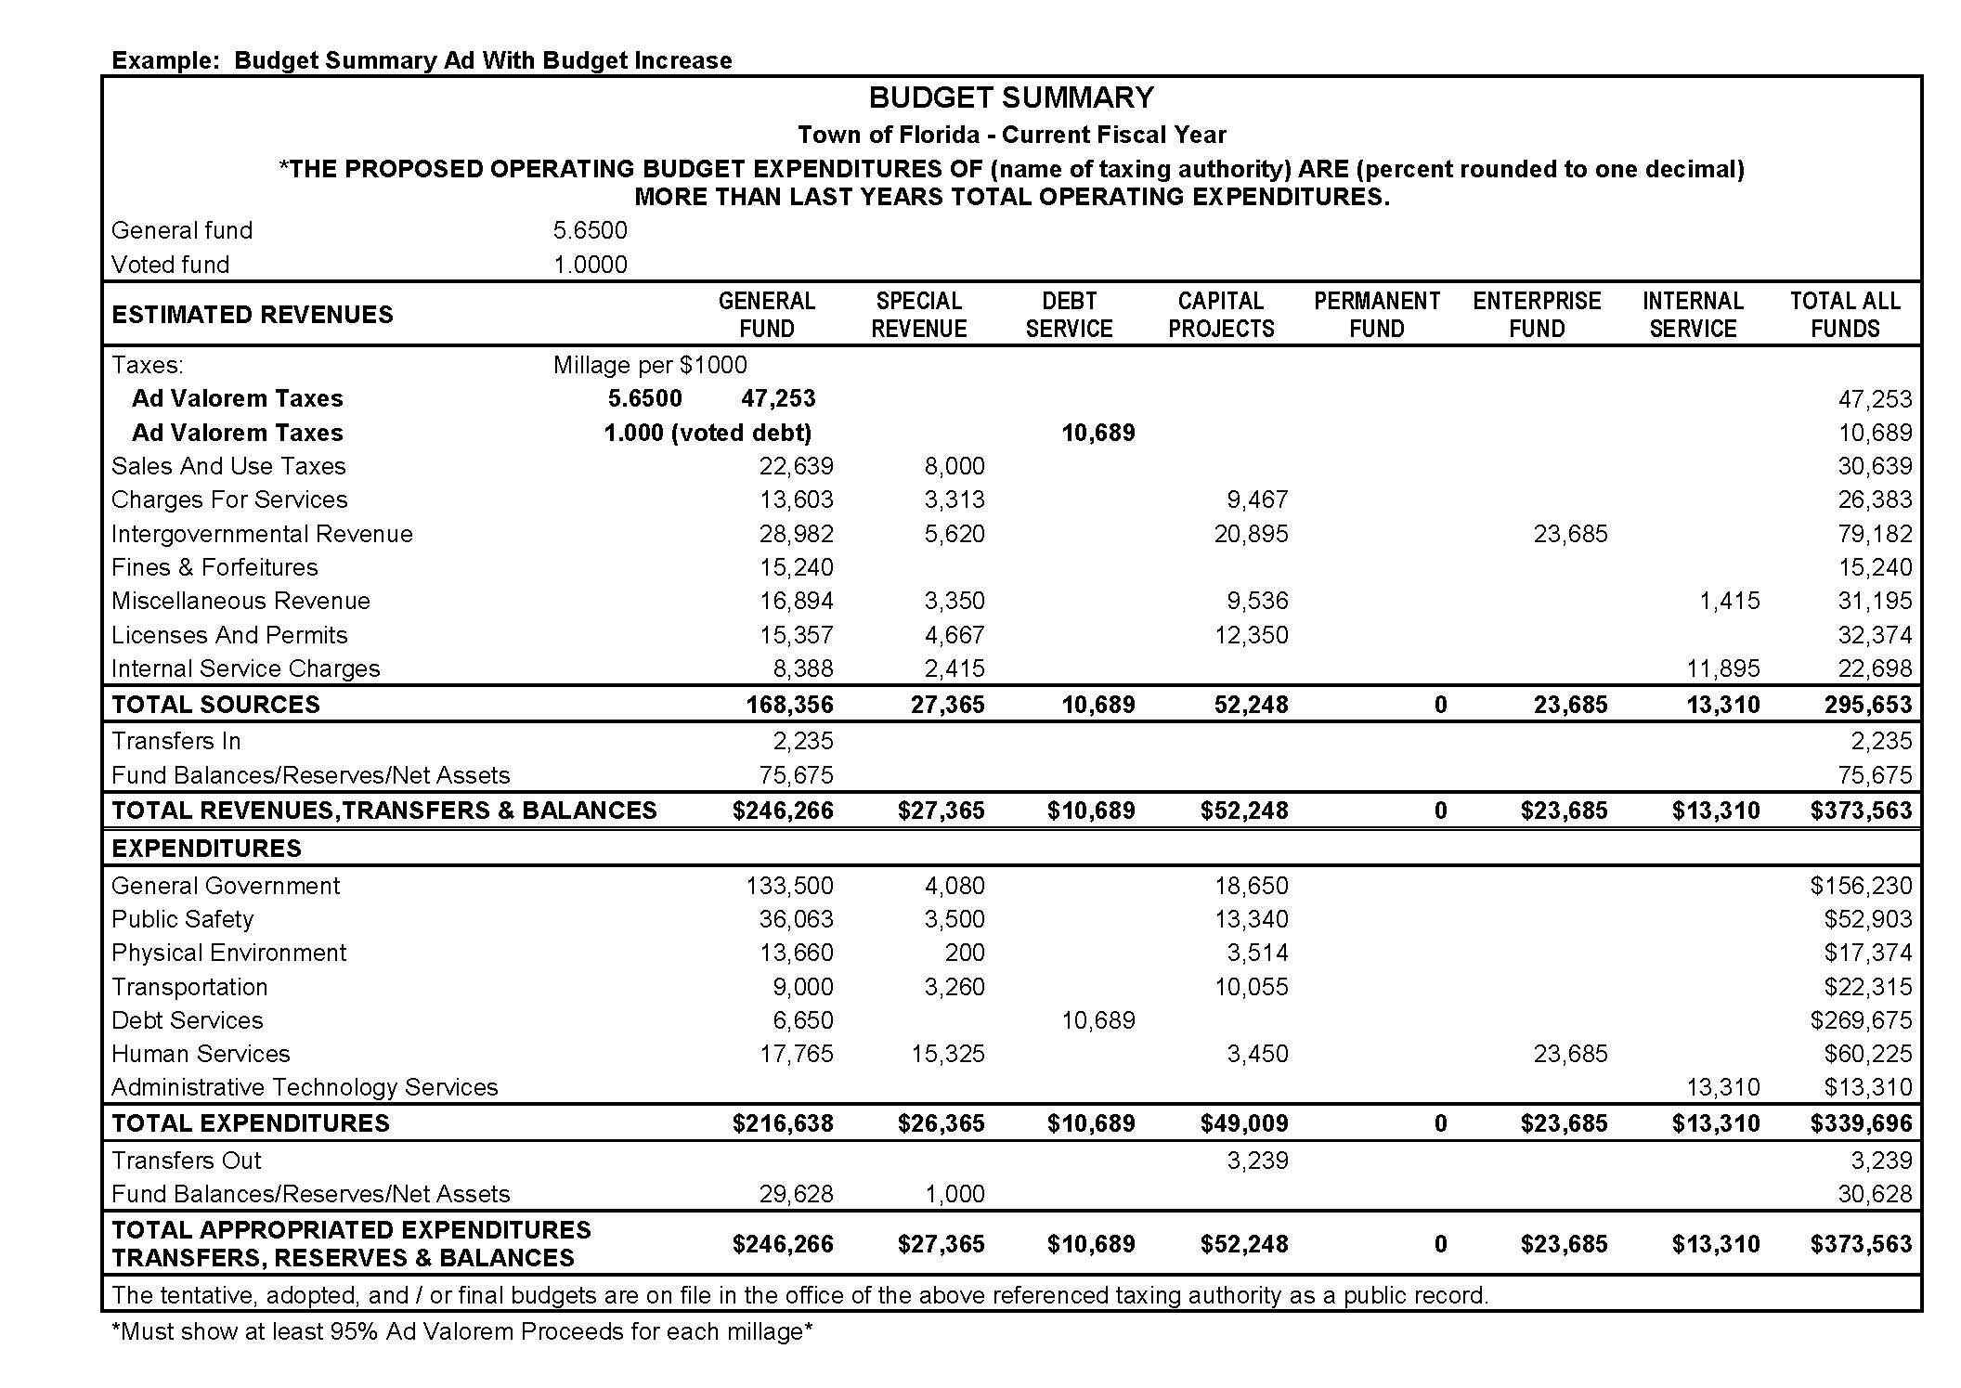
TRIM Advertising Requirements Budget Summary Ad

Slide 62
TRIM Advertising Requirements Recessed Hearing Information
If the hearing is recessed, the taxing authority must publish a Notice of Continuation in a newspaper of general paid circulation in the county.
The notice must state the time, date, and location of the hearing.
Do not adjourn the hearing. The hearing is to be recessed.

Slide 63
TRIM Advertising Requirements Recessed Hearing Information EXAMPLE
NOTICE OF CONTINUATION
The tentative/final budget hearing held on (Date of hearing)
For the (name of taxing authority) was recessed and will be continued on
(Date, time, and location of new hearing).
(Include name of town)

Slide 64
TRIM Advertising Requirements Rescheduled Hearing Information
If a hearing is postponed or rescheduled due to circumstances beyond its control, the taxing authority should publish a Notice of Rescheduled Hearing in a newspaper of general paid circulation in the county.
The notice must state the time, date, and location of the rescheduled hearing.

Slide 65
TRIM Advertising Requirements Rescheduled Hearing Information EXAMPLE
NOTICE OF RESCHEDULED HEARING
The tentative/final hearing adopting a millage and budget on (hearing date)
for the (name of taxing authority) is being rescheduled due to (named storm).
A rescheduled (tentative/final) budget hearing will be held on:
(Date, time, and meeting place)

Slide 66
TRIM Advertising Requirements Proof of Publications
Submit one for each published advertisement
Submit with Certification of Compliance
(Form DR-487)

Slide 67
Resolutions/Ordinances

Slide 68
TRIM Resolution/Ordinance
The taxing authority cannot levy any millage until its governing board has approved a resolution or ordinance.

Slide 69
Millage Resolutions/Ordinances

Slide 70
TRIM Millage Resolution/Ordinance
The tentative and final resolution/ordinance adopting millage rates must include:
The taxing authority’s name
The percentage increase over the rolled-back rate
Each adopted millage rate
The rolled-back rate

Slide 71
TRIM Budget Resolution/Ordinance
Must be adopted by separate vote after the millage adoption
If order of millage and budget adoption cannot be determined, send minutes of meeting
When the property appraiser receives the resolution or ordinance, it is considered official notice of the millage rate the taxing authority approved.

Slide 72
Budget Resolution

Slide 73
TRIM Resolution/Ordinance
Within three days following the final hearing, forward the resolution/ordinance adopting final millage to the:
Property appraiser
Tax collector
Department of Revenue
trim@floridarevenue.com

Slide 74
Certifying Compliance
to the Department

Slide 75
Certification of TRIM Compliance
Forms:
Certification of Compliance (Form DR-487)
Maximum Millage Levy Calculation – Final Disclosure (Form DR-420MM)
Vote Record for Final Adoption of Millage Levy (Form DR-487V)

Slide 76
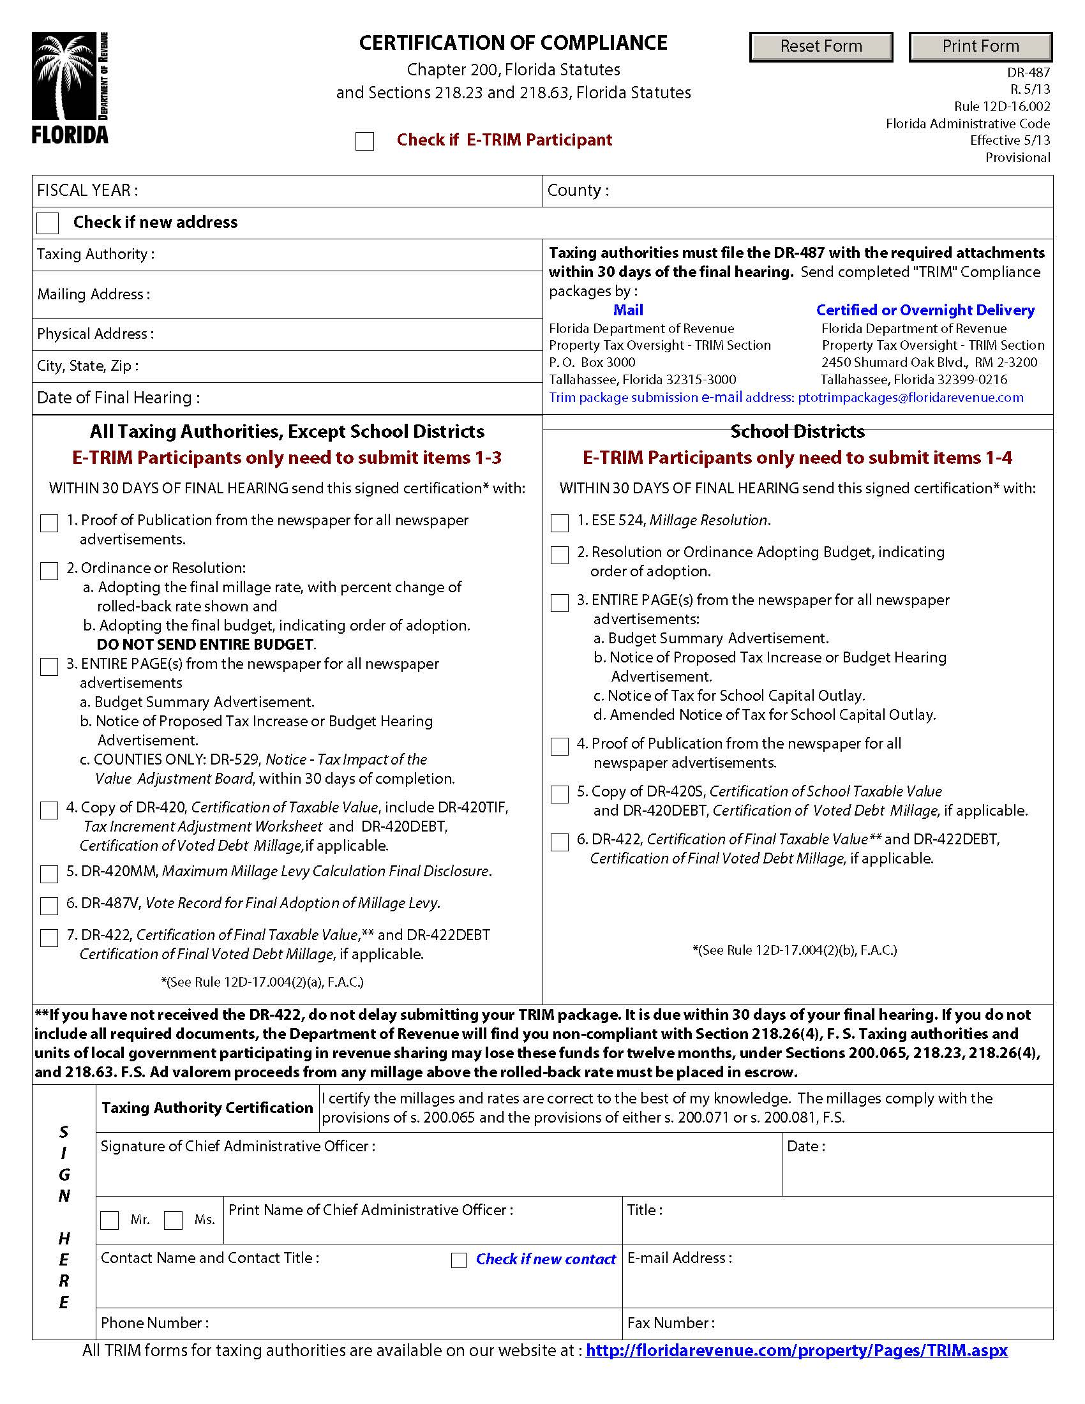
Certification of Compliance (Form DR-487)

Slide 77
Maximum Millage Levy Calculation Final Disclosure (Form DR-420MM)

Slide 78
Vote Record for Final Adoption of Millage Levy (Form DR-487V)

Slide 79
Electronic Submission
When submitting the TRIM compliance package to the TRIM section electronically, you must:
Include the taxing authority number (that is provided to you by the TRIM section)and taxing authority name, and state “TRIM Compliance Package” in the subject line
Include in the package:
Form DR-487
Millage and/or ordinance adopting the final millage rate
Millage and/or ordinance adopting the final budget
Entire page of the newspaper for all TRIM advertisements
Proof of publications from the newspaper for all TRIM advertisements
If you used mailed notices in lieu of newspaper advertisements, you must include a copy of the mailed notices and proof of mailing from the post office
Use this following email address to submit: ptotrimpackages@floridarevenue.com

Slide 80
TRIM Value Adjustment Board Information
The VAB has five members: two from the county’s board of county commissioners, one from the county’s school board, and two citizens.
The purpose of the VAB is to hear appeals regarding:
Property value assessments
Denied exemptions or classifications
Ad valorem tax deferrals, portability decisions, and change of ownership or control
The VAB meets 30 – 60 days after mailing of the TRIM notice.
The VAB remains in session from day to day until the board has heard all petitions, complaints, appeals, and disputes.

Slide 81
Final Taxable Value
Forms:
Certification of Final Taxable Value (Form DR-422)
Certification of Final Voted Debt Millage (Form DR-422DEBT)

Slide 82
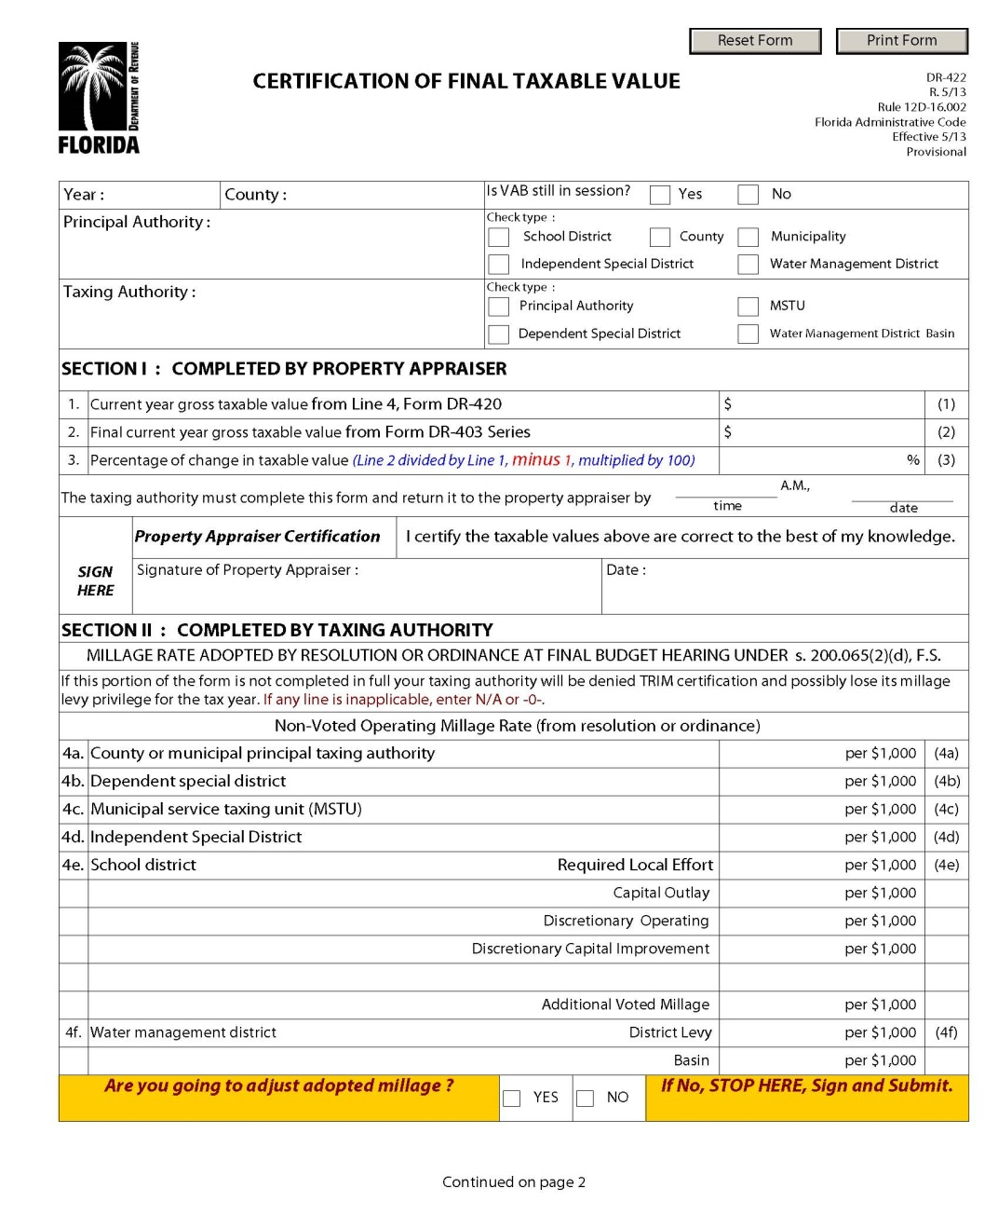
Certification of Final Taxable Value (Form DR-422)

Slide 83
Certification of Final Taxable Value (Form DR-422)
The taxing authority may adjust millage rate.

Slide 84
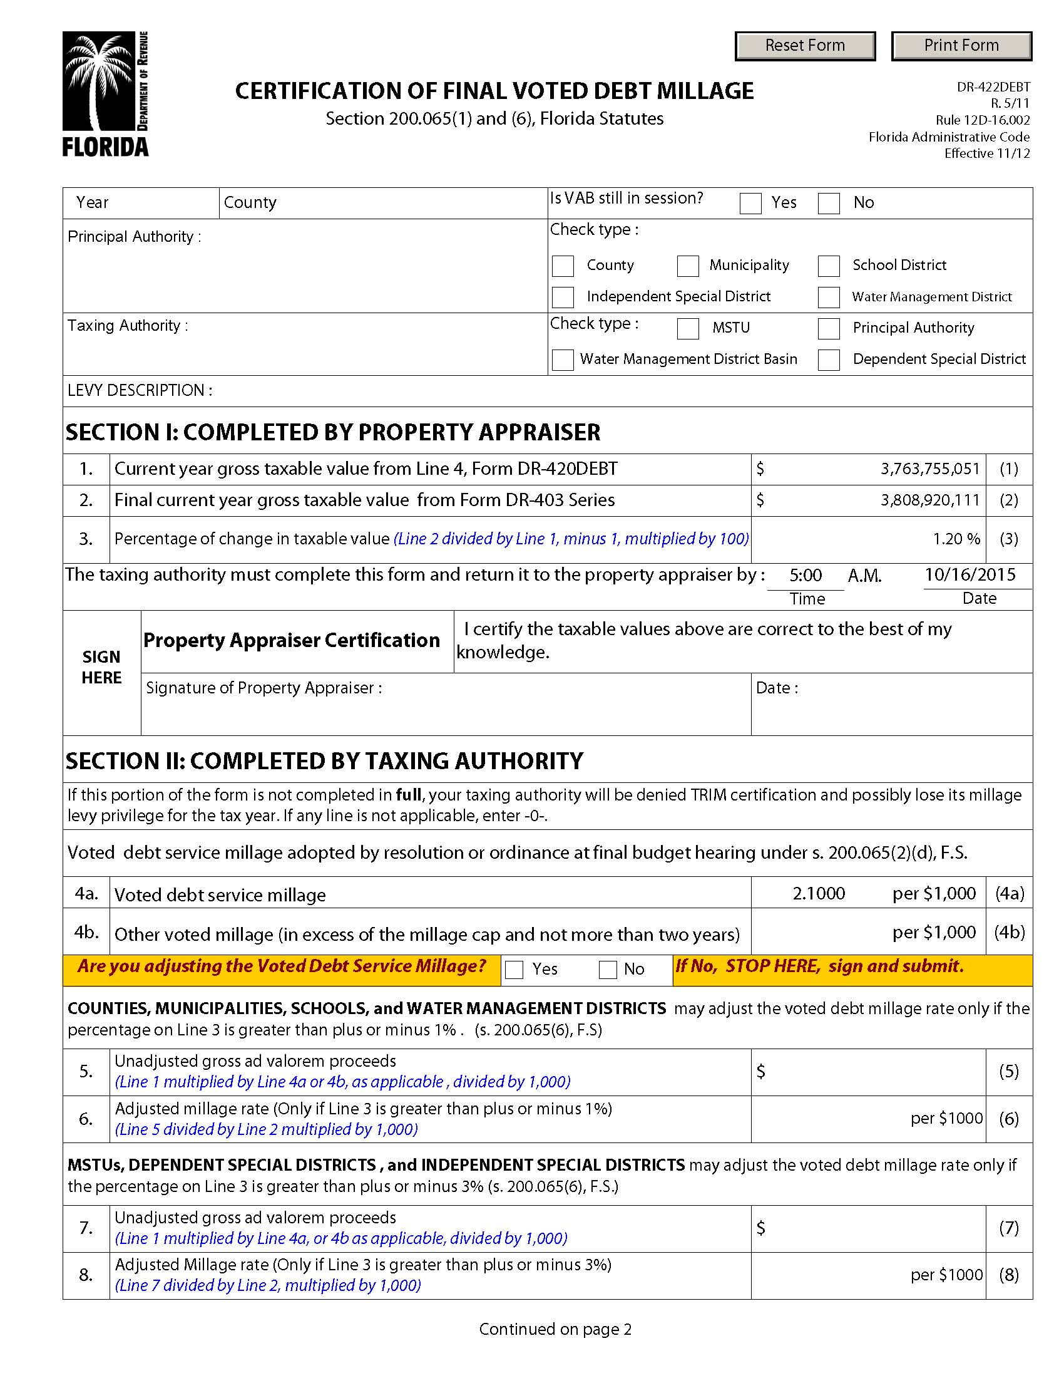
Certification of Final Voted Debt Millage (Form DR-422DEBT)

Slide 85
2020 Top Infractions and Violations
Incorrect verbiage in advertisement
Tax levy incorrect/percent increase incorrect
Late package
Ad valorem proceeds not shown or incorrect
Wrong size advertisement

Slide 86
TRIM Compliance Contacts
TRIM STAFF | PHONE NUMBER
Wyatt Peters | (850) 617-8921
Dametria Hayward-Williams | (850) 617-8922
Kendall Tolbert | (850) 617-8861
Breauna Hines | (850) 617-8923
Roberta Epp | (850) 617-8890
Fax Number | (850) 617-6115
TRIM Email Address eTRIM Email Address TRIM Package Submission Email | TRIM@floridarevenue.com eTRIM@floridarevenue.com ptotrimpackages@floridarevenue.com

Slide 87
Thank you for your participation today!

