Slide 1
Introduction to Electronic Truth in Millage (eTRIM)
Property Tax Oversight
2021

Slide 2
What is eTRIM?
The Department of Revenue’s internet-based system for completing and submitting documents and data for:
Truth in Millage
Maximum Millage

Slide 3
eTRIM History
Launched in 2010
12 property appraisers piloted
In 2021
66 participating property appraisers
630 participating taxing authorities

Slide 4
Benefits of Using eTRIM
Fewer errors
More efficient than traditional methods
Reduces paper use

Slide 5
Success with eTRIM
For successful use, this system requires participation from the property appraiser's office and all taxing authorities in the county.
The following overview gives a general demonstration of the system.

Slide 6
Log-on Screen

Slide 7
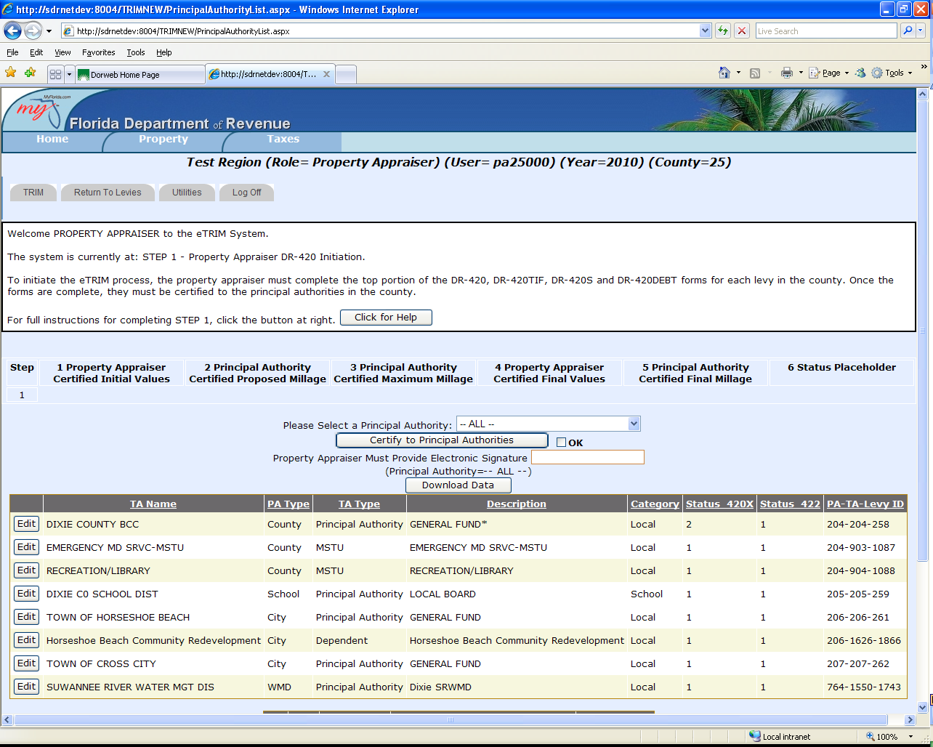
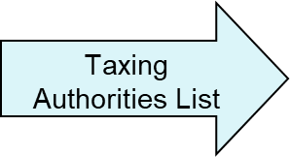
Overview of Property Appraiser’s Summary Page
Status
Box

Slide 8
Some Functions of Property Appraiser’s Summary Page
From the summary page the property appraiser can:
Access individual forms for data entry and editing
Upload/download TRIM data
View data entry of each levy
Certify completed forms to taxing authorities
Accept submitted data from taxing authorities

Slide 9
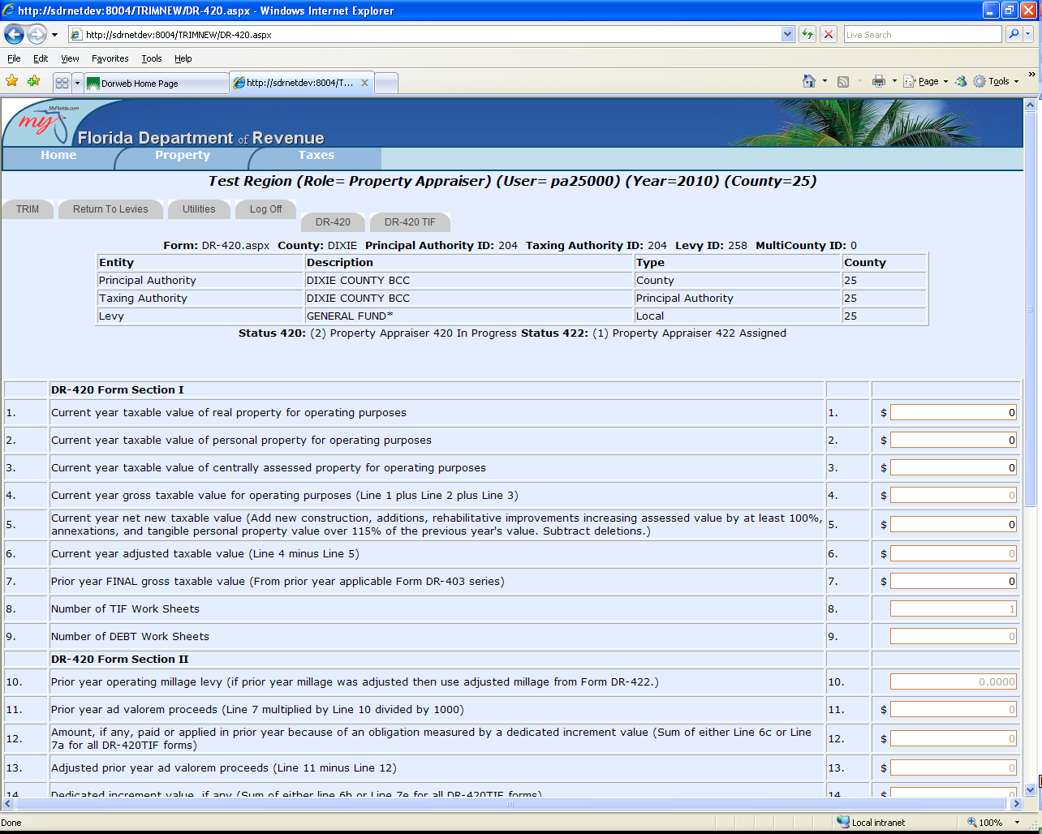
Forms DR-420 and DR-420TIF and Other TRIM Forms
On this screen, the property appraiser completes required entries. Then eTRIM then automatically calculates other fields.

Slide 10
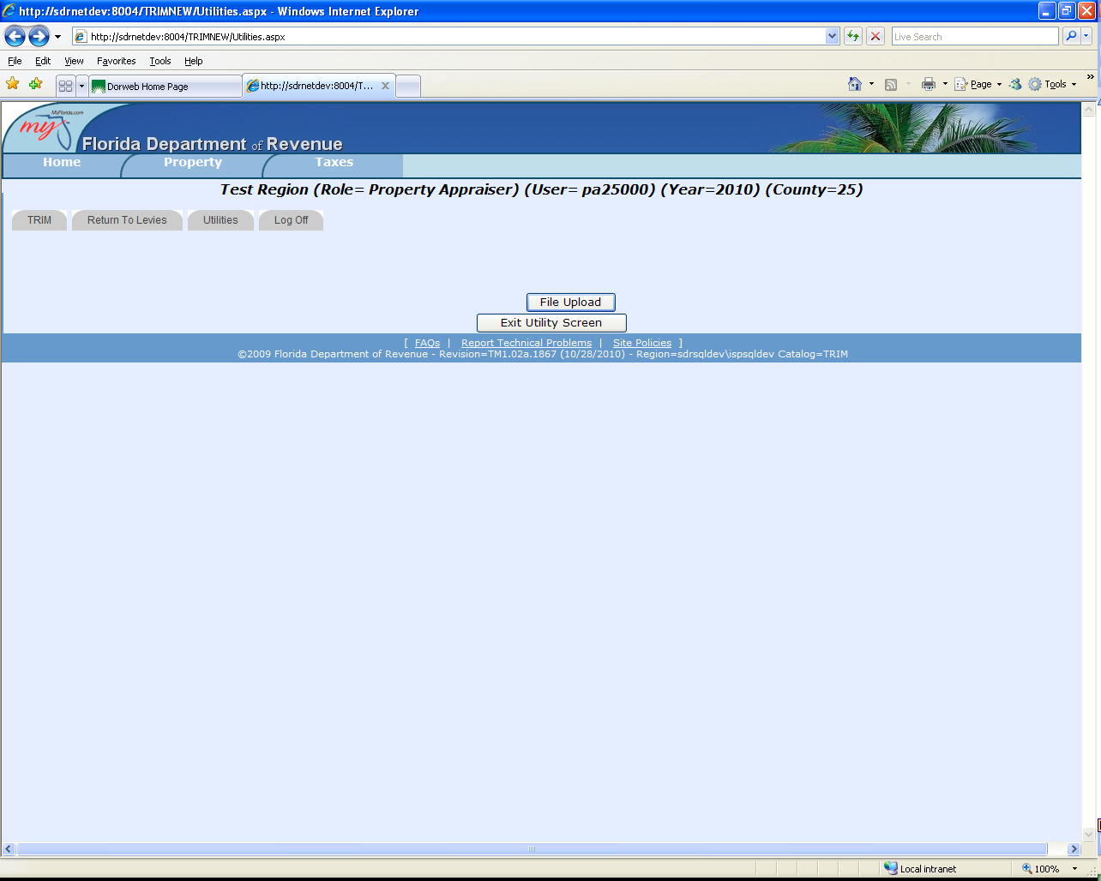
Data Upload Screen
The property appraiser has the option of uploading the file rather than keying in data.

Slide 11
Property Appraiser’s Certification
The property appraiser can certify initial/final values to the principal authorities.

Slide 12
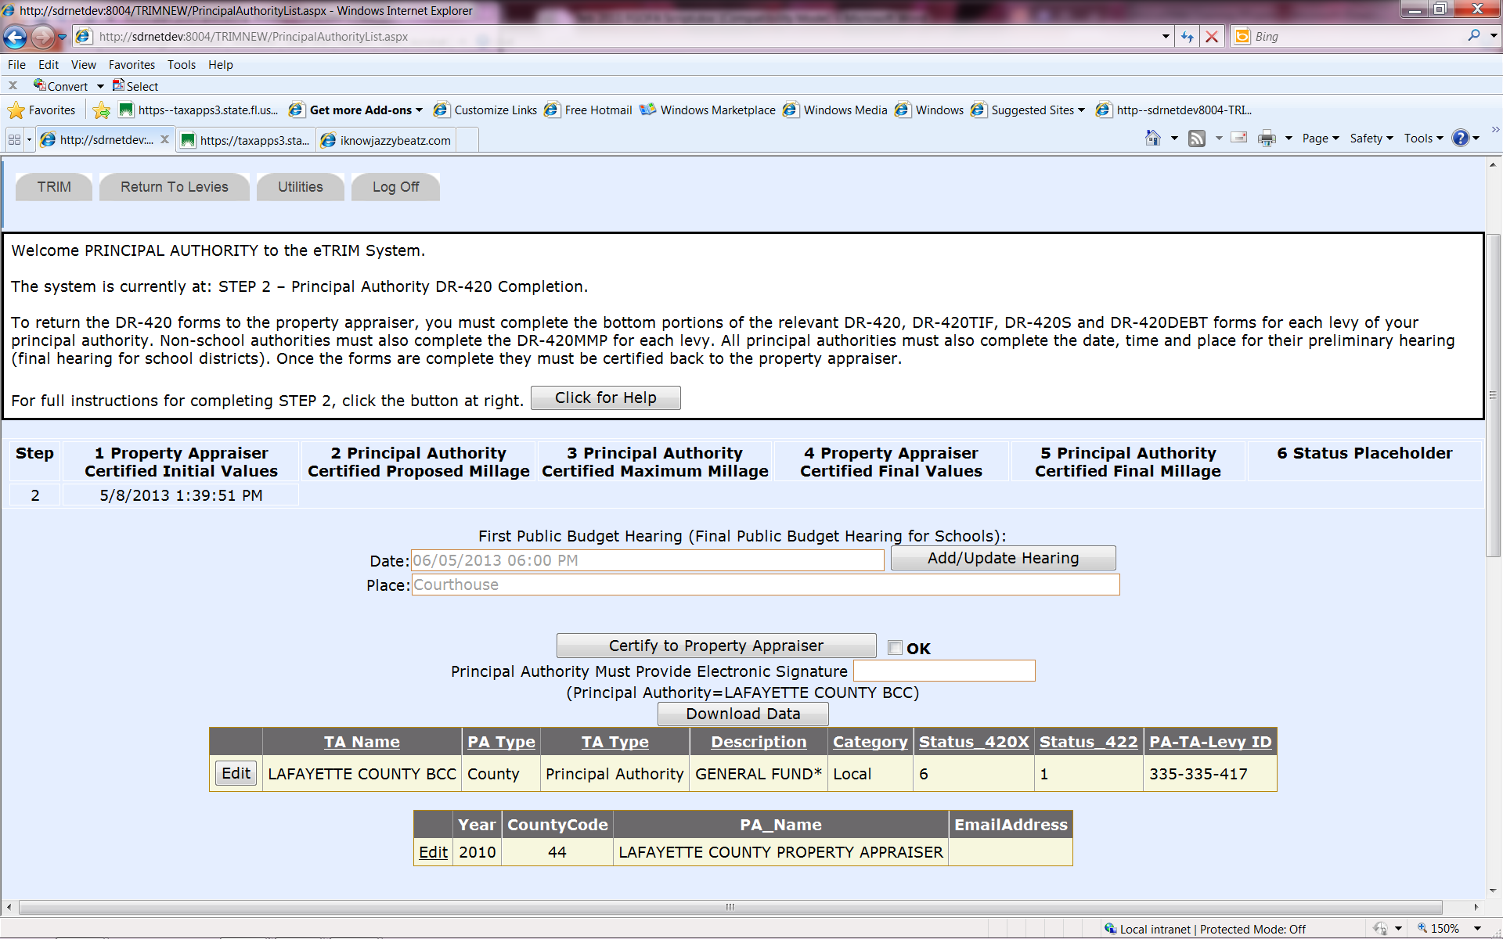
Principal Authority’s Summary Page

Slide 13
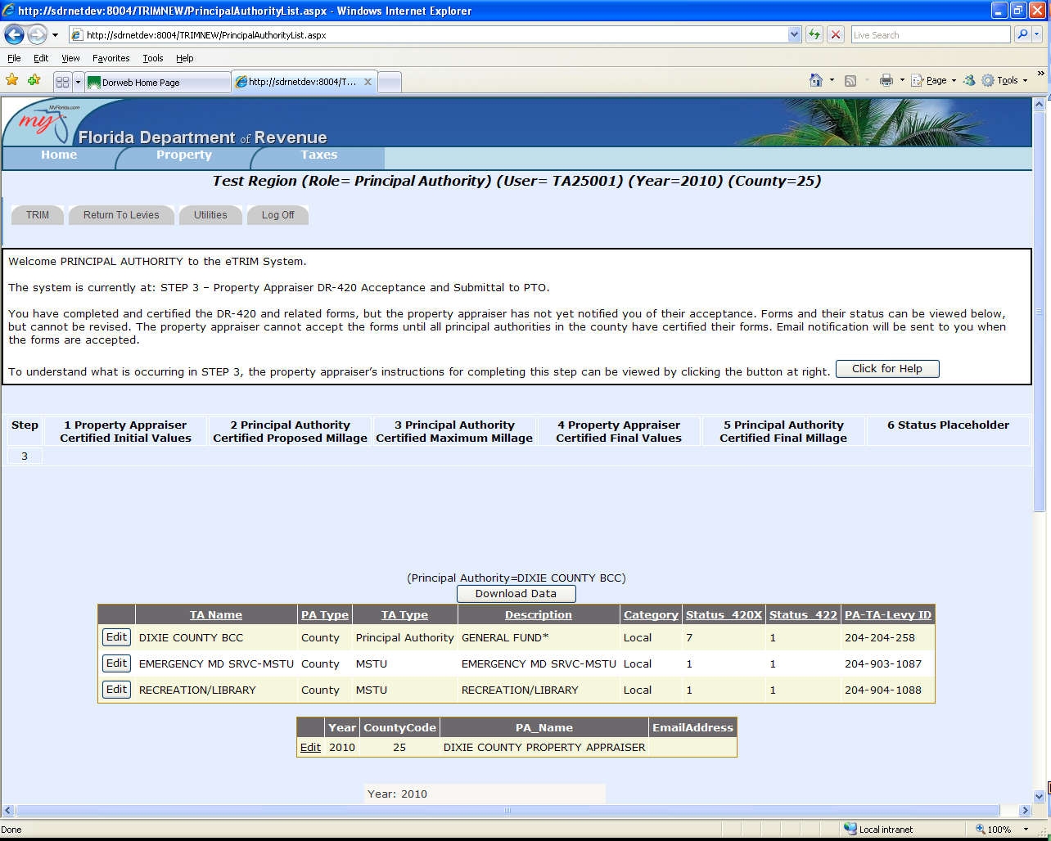
Status Box and Levy List on Principal Authorities’ Summary Page
Status Box
Levy List

Slide 14
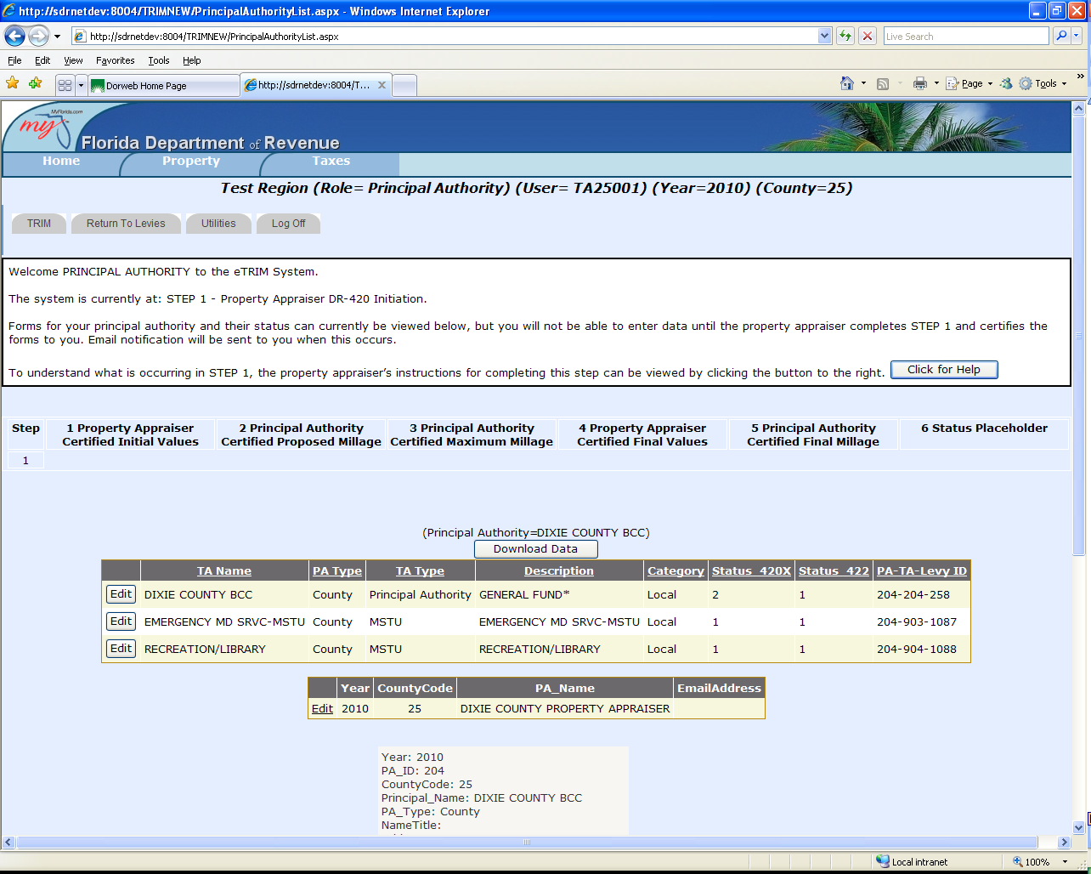
More Functions of Principal Authorities’ Summary Page
On this screen, the taxing authority can:
Enter/edit data
Enter date, time, and location of hearing
View each levy’s data entry
Certify completed forms to property appraiser

Slide 15
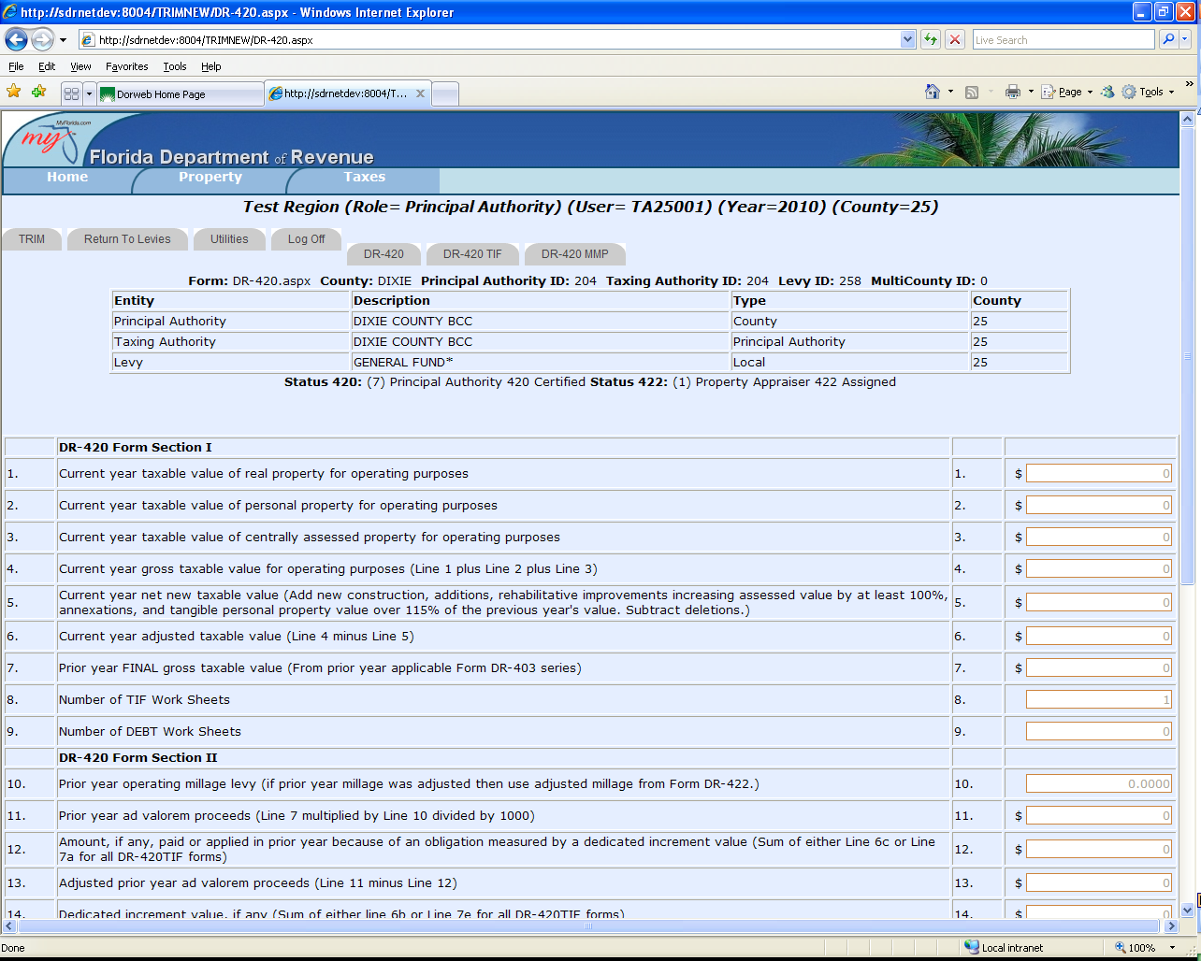
Forms DR-420, DR-420TIF, and DR-420MM-P and Other TRIM Forms
On this screen, the taxing authority completes required entries. Then eTRIM automatically calculates other fields.

Slide 16
TRIM Compliance Contacts
TRIM STAFF | PHONE NUMBER
Wyatt Peters | (850) 617-8921
Dametria Hayward-Williams | (850) 617-8922
Kendall Tolbert | (850) 617-8861
Breauna Hines | (850) 617-8923
Roberta Epp | (850) 617-8890
Brendan Savage | (850) 617-8879
Fax Number | (850) 617-6115
TRIM Email Address eTRIM Email Address | TRIM@floridarevenue.com eTRIM@floridarevenue.com

Slide 17
Thank you for your participation today!

